Slide 1
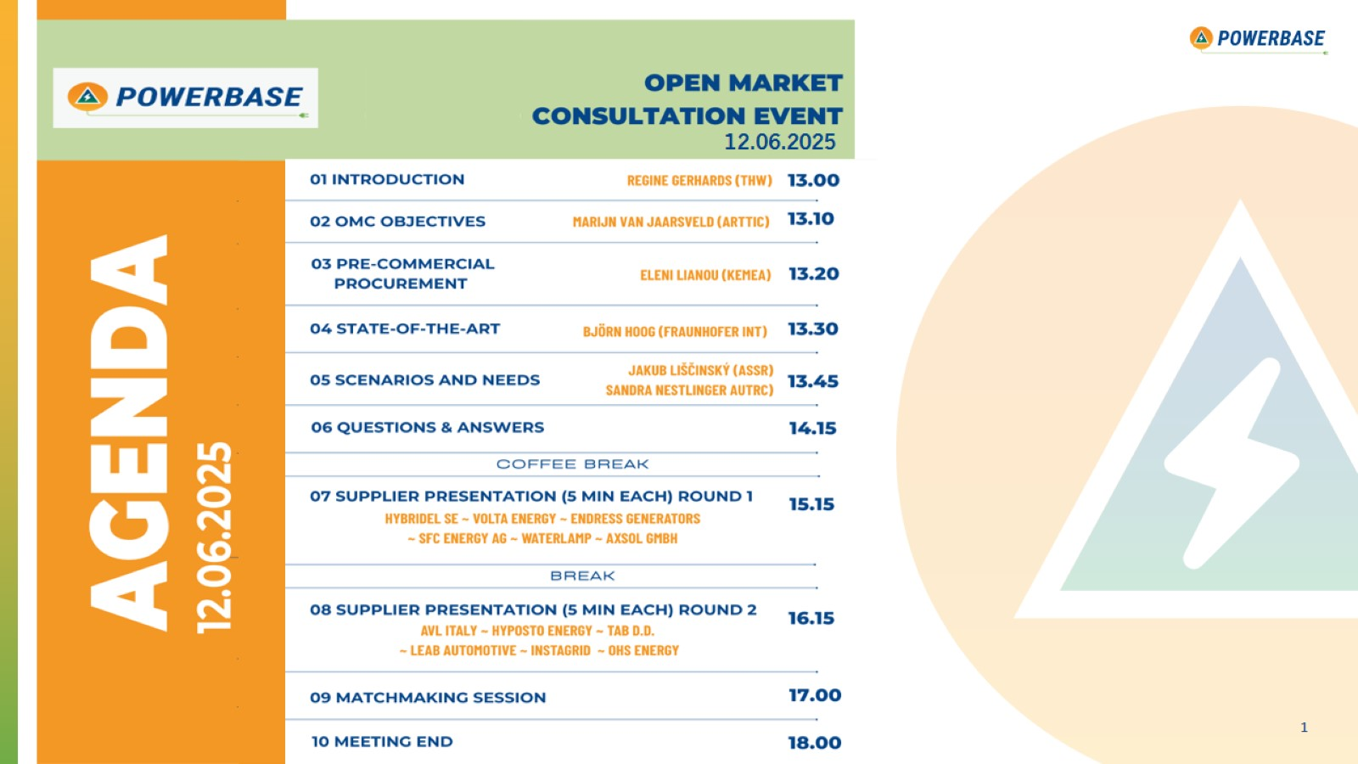

Slide 2

Introduction

Slide 3


Slide 4
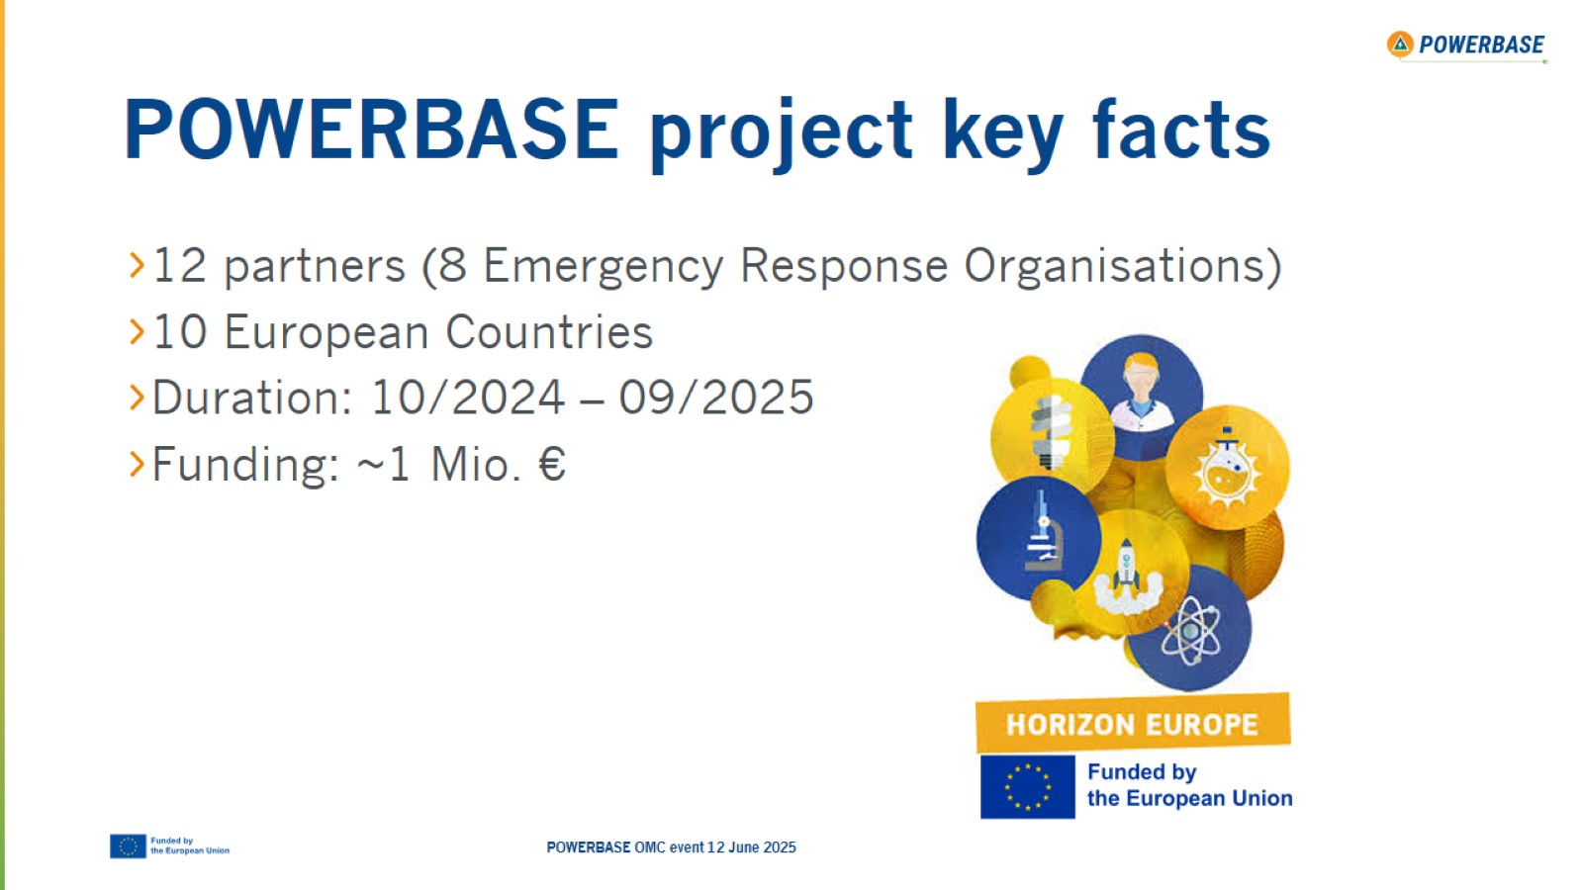
POWERBASE project key facts

Slide 5

Partners

Slide 6
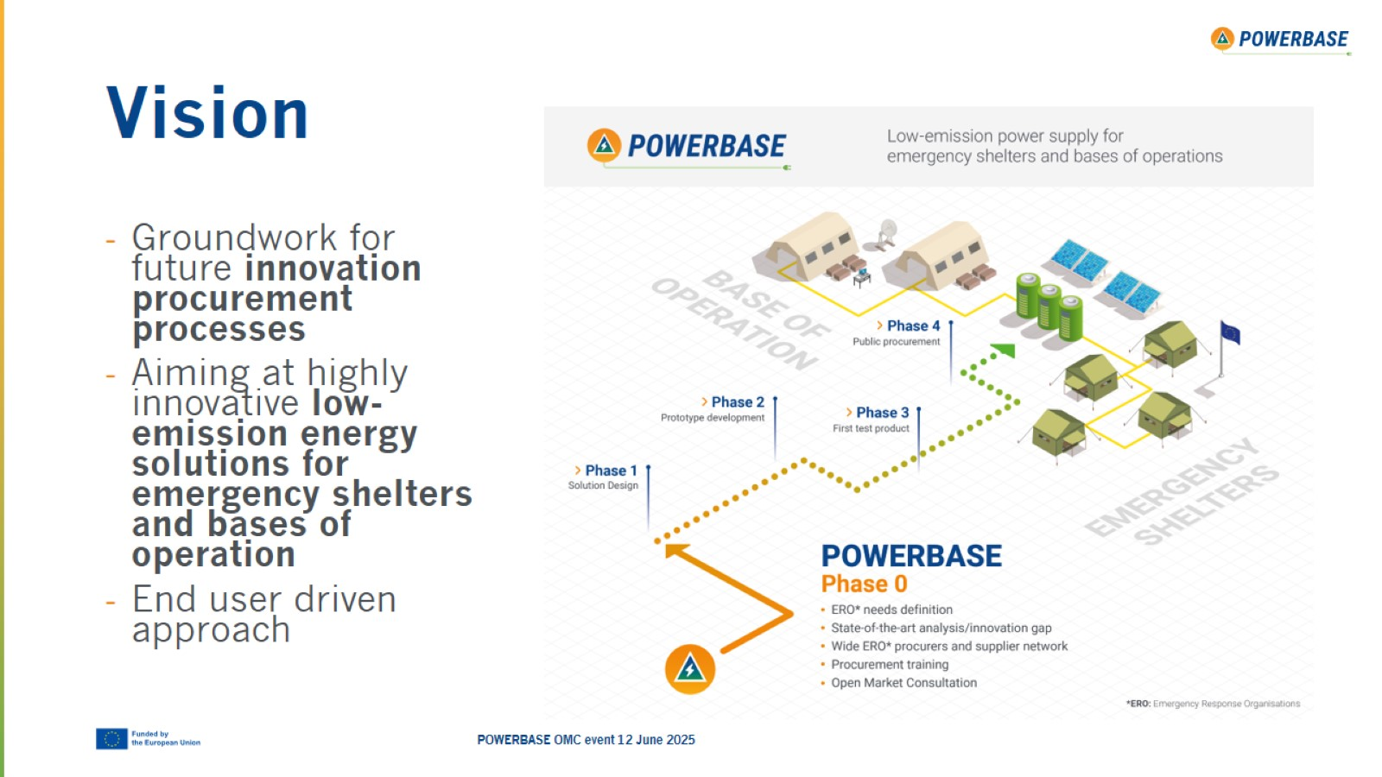
Vision

Slide 7
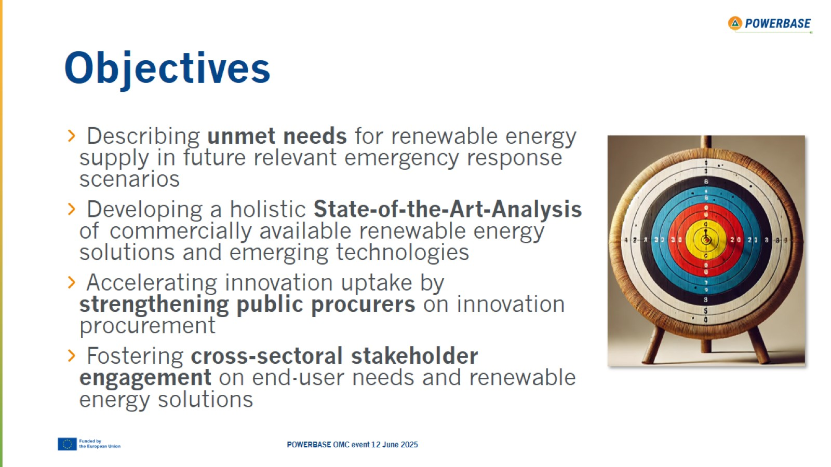
Objectives

Slide 8
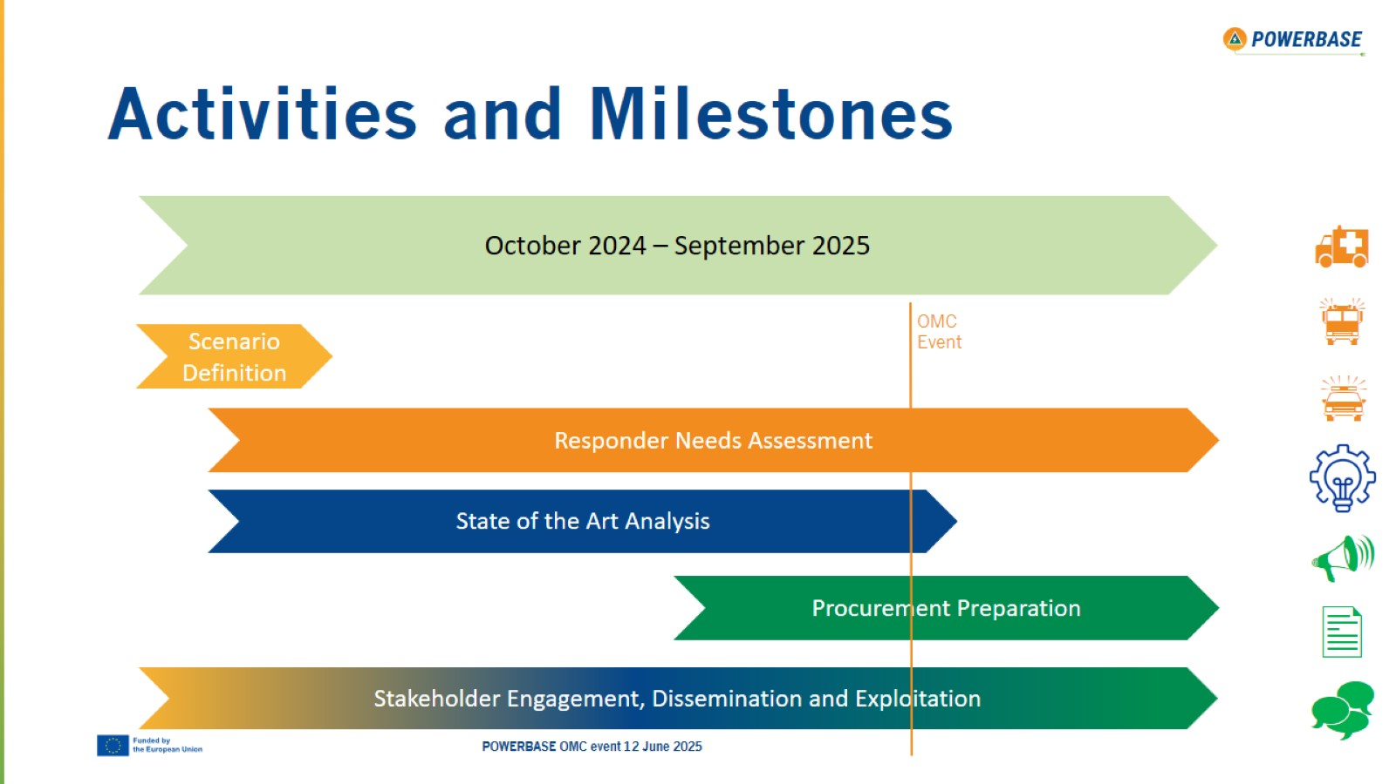
Activities and Milestones

Slide 9
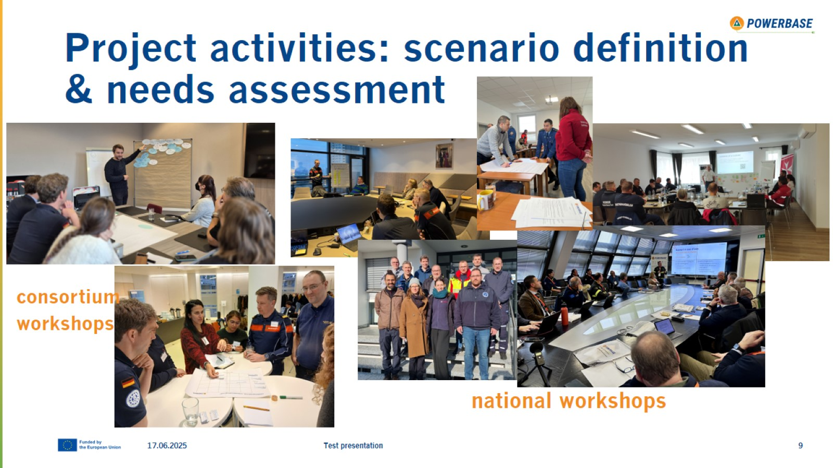
Project activities: scenario definition & needs assessment

Slide 10

Technologies presented today

Slide 11

Thank you

Slide 12

OMC Objectives

Slide 13
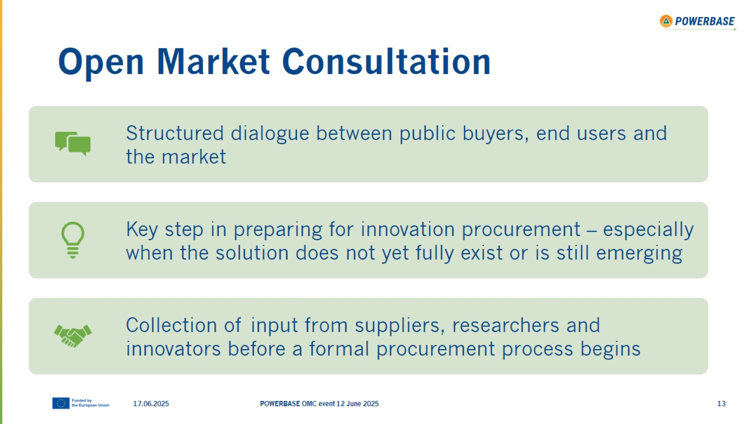
Open Market Consultation

Slide 14
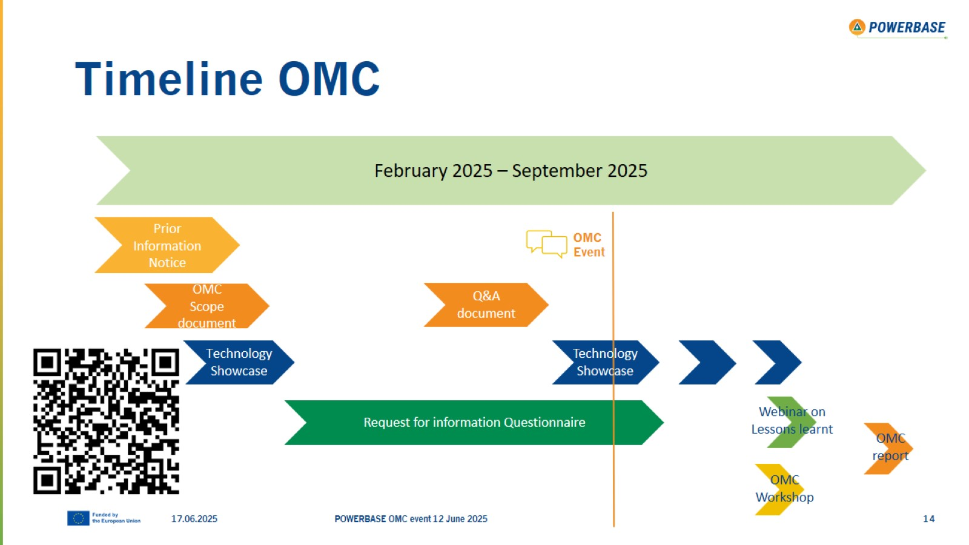
Timeline OMC

Slide 15
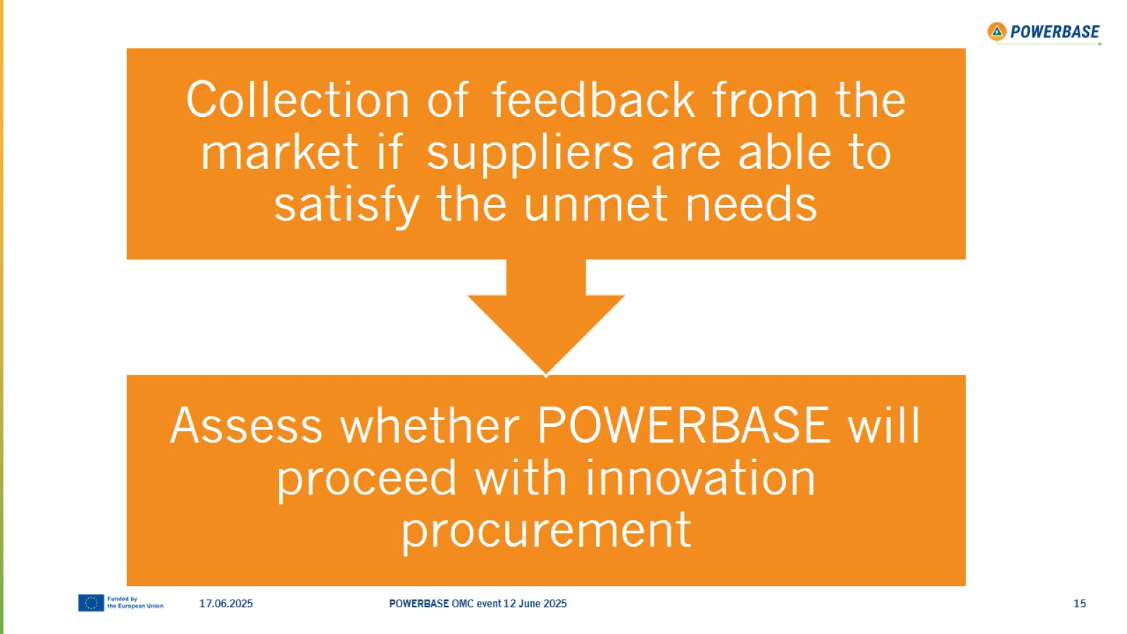

Slide 16
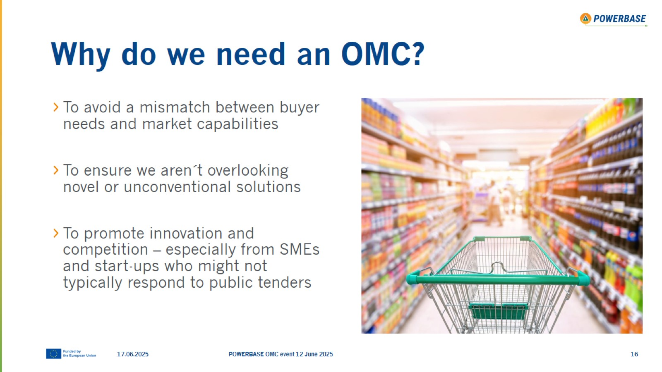
Why do we need an OMC?

Slide 17
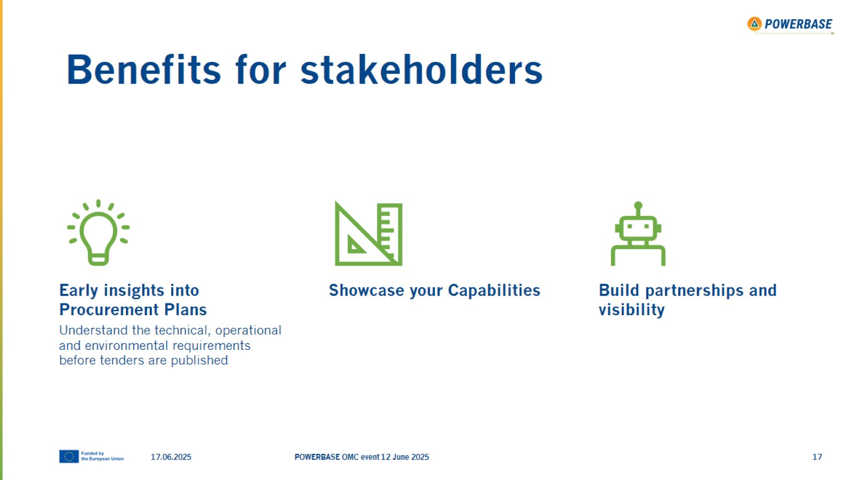
Benefits for stakeholders

Slide 18
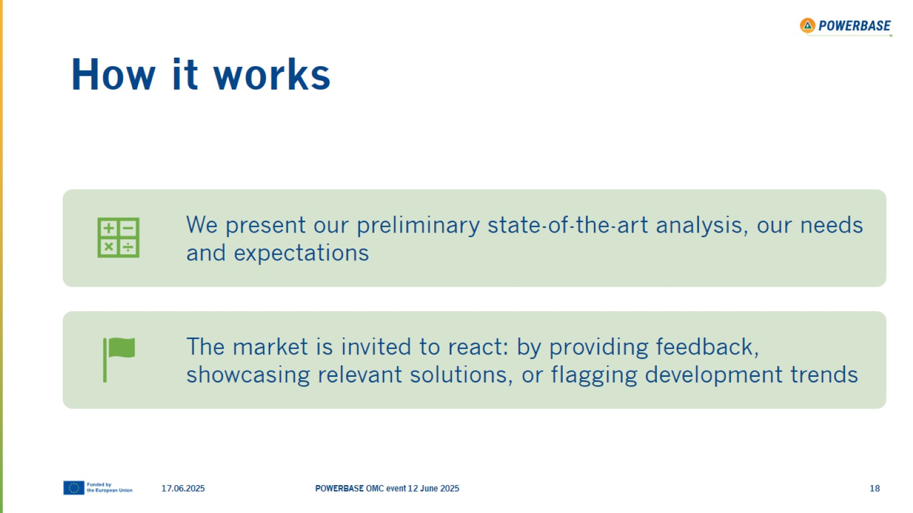
How it works

Slide 19

Fill out our Request for Information Questionnaire!

Slide 20

Timeline OMC

Slide 21


Slide 22

Thank you!

Slide 23

Pre-Commercial Procurement

Slide 24
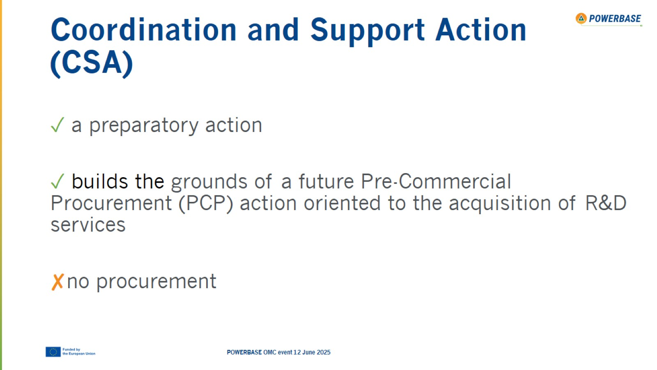
Coordination and Support Action (CSA)

Slide 25
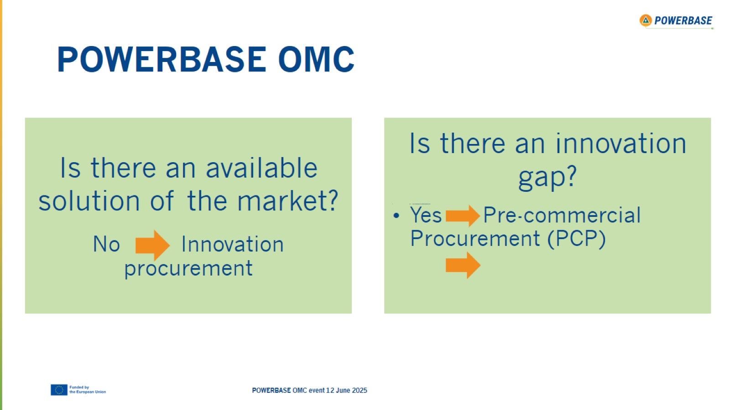
POWERBASE OMC

Slide 26
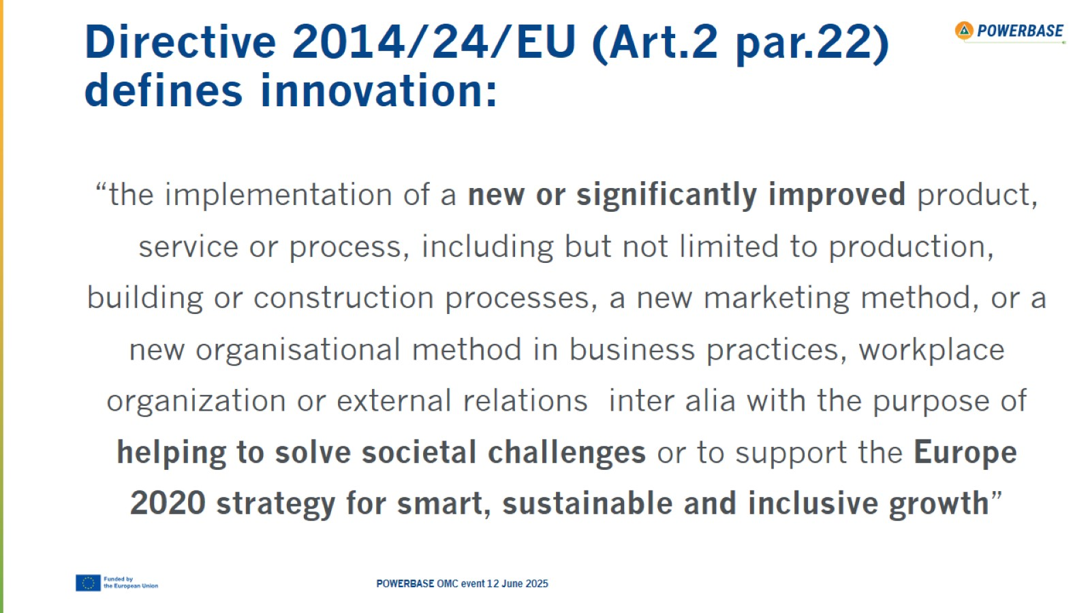
Directive 2014/24/EU (Art.2 par.22) defines innovation:

Slide 27
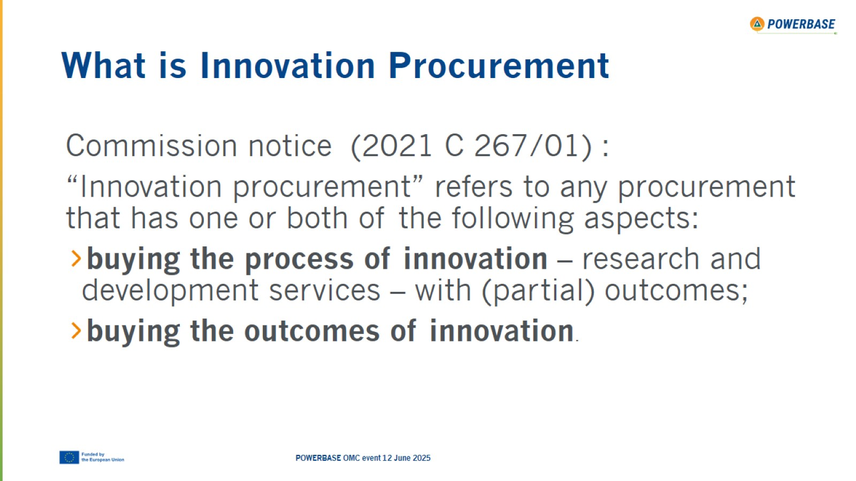
What is Innovation Procurement

Slide 28
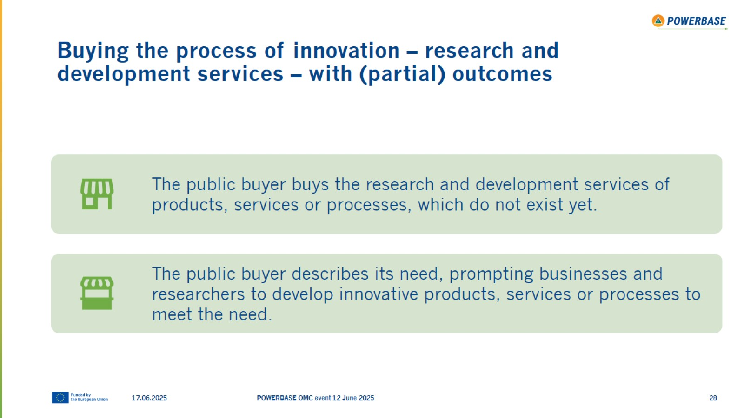
Buying the process of innovation – research and development services – with (partial) outcomes

Slide 29
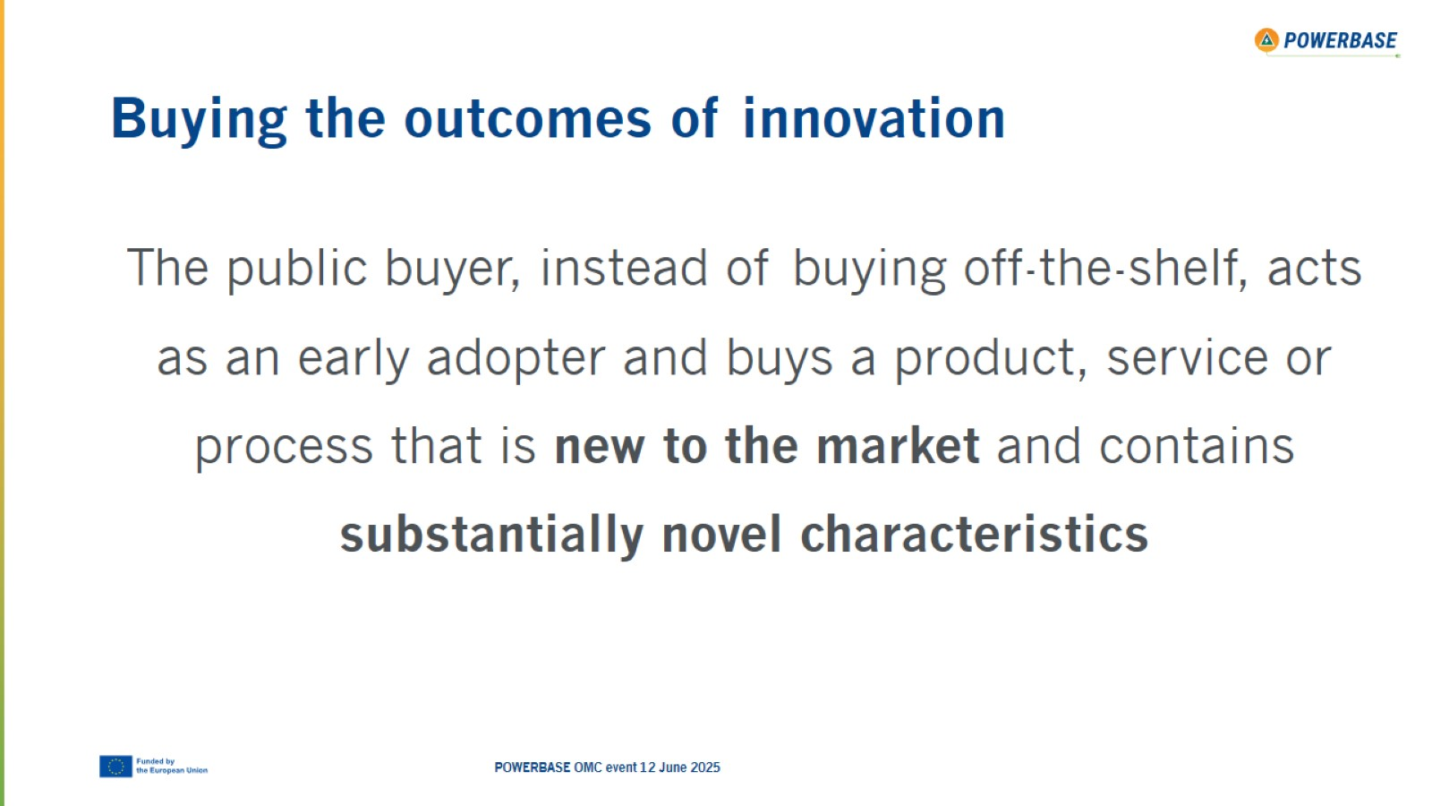
Buying the outcomes of innovation

Slide 30
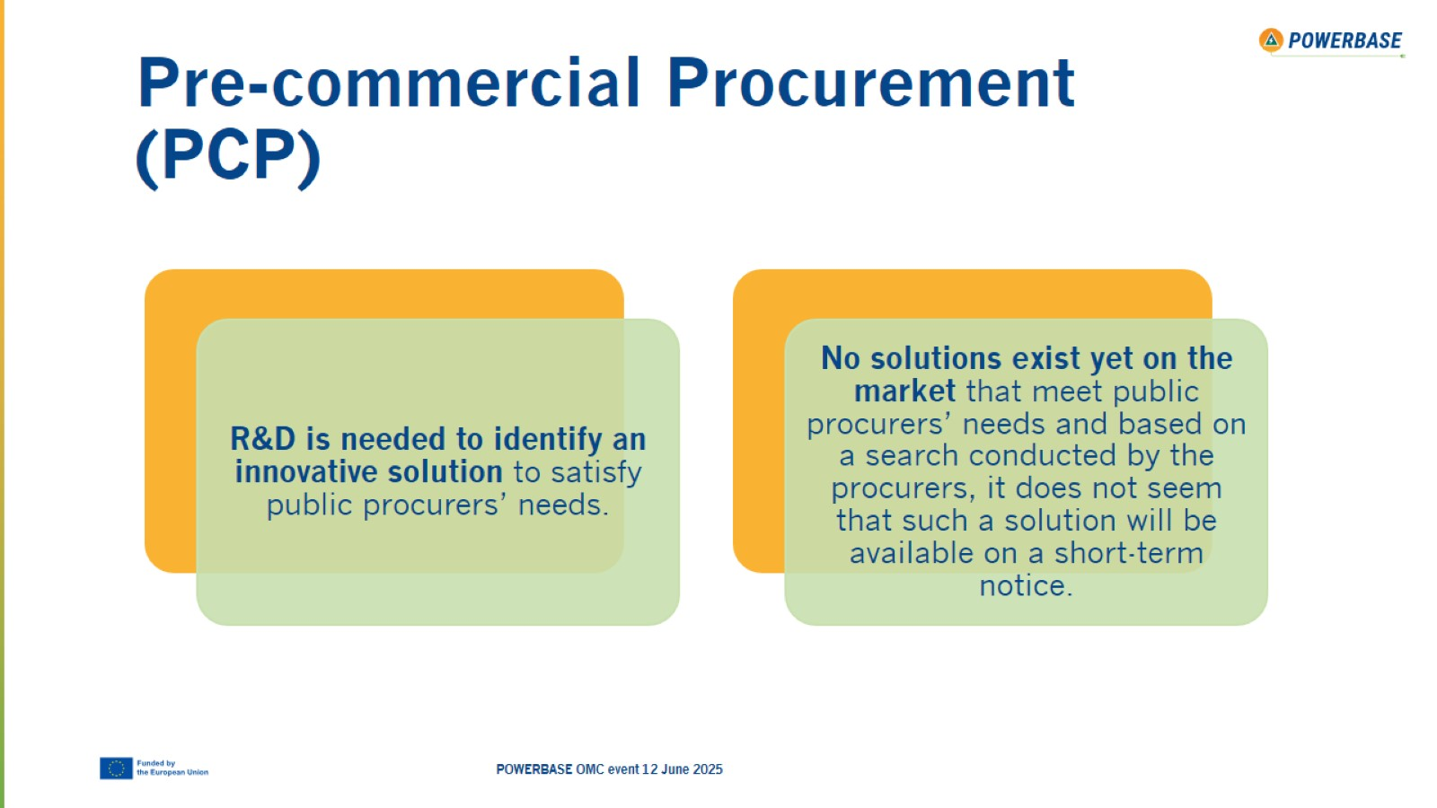
Pre-commercial Procurement (PCP)

Slide 31
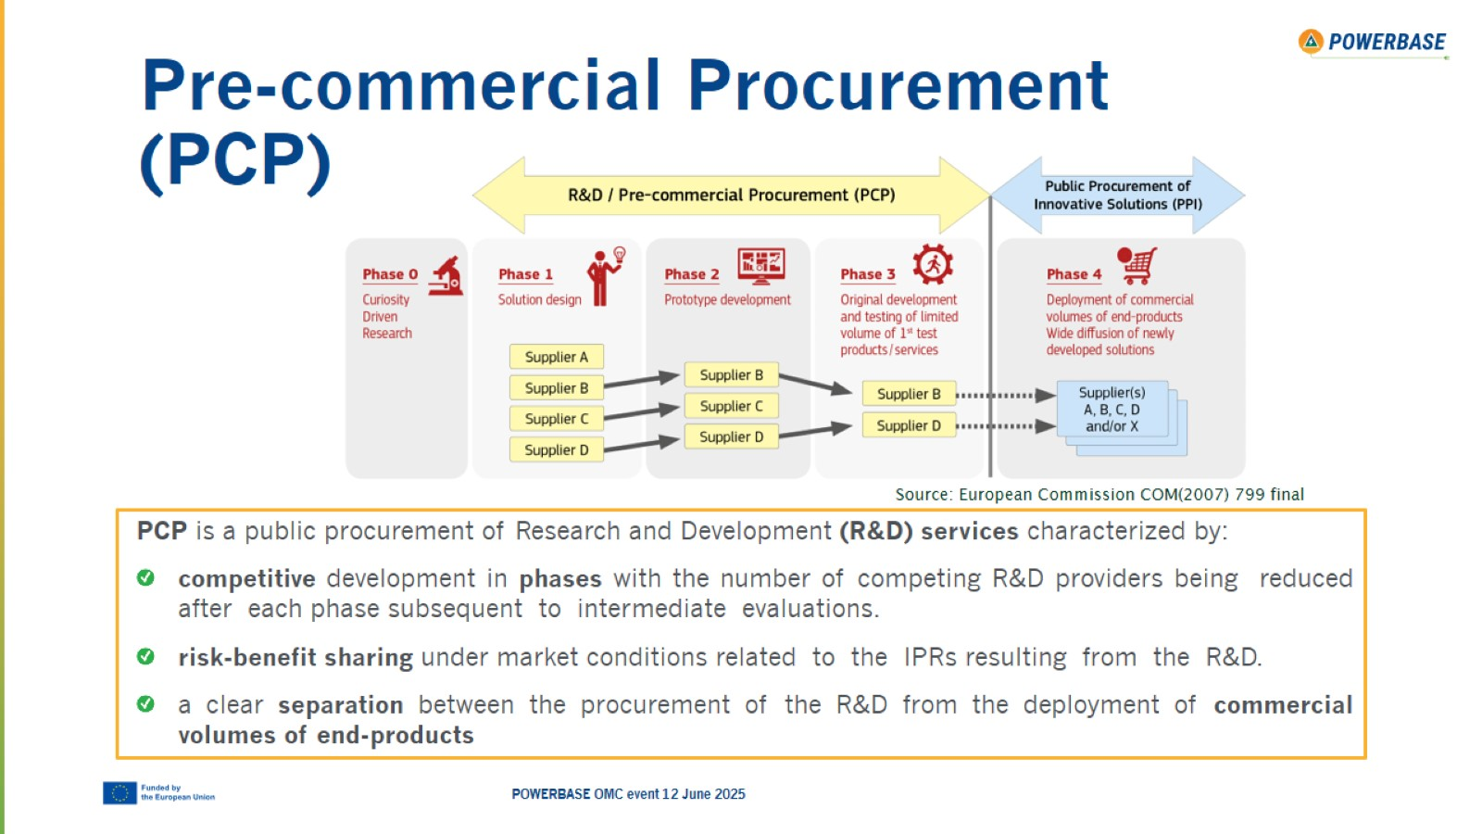
Pre-commercial Procurement (PCP)

Slide 32
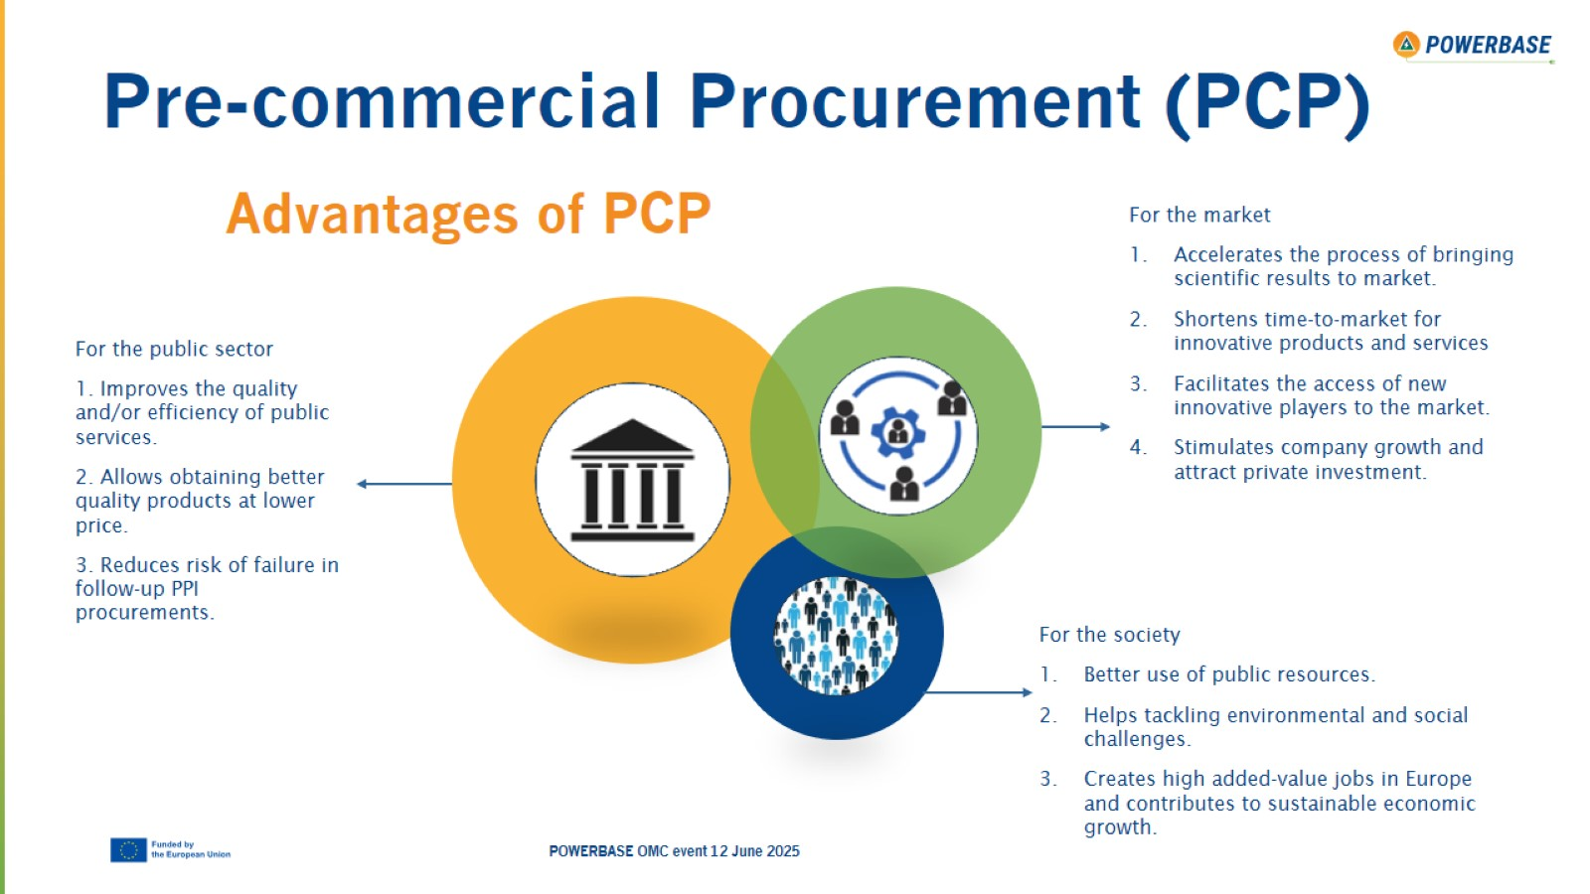
Pre-commercial Procurement (PCP)

Slide 33
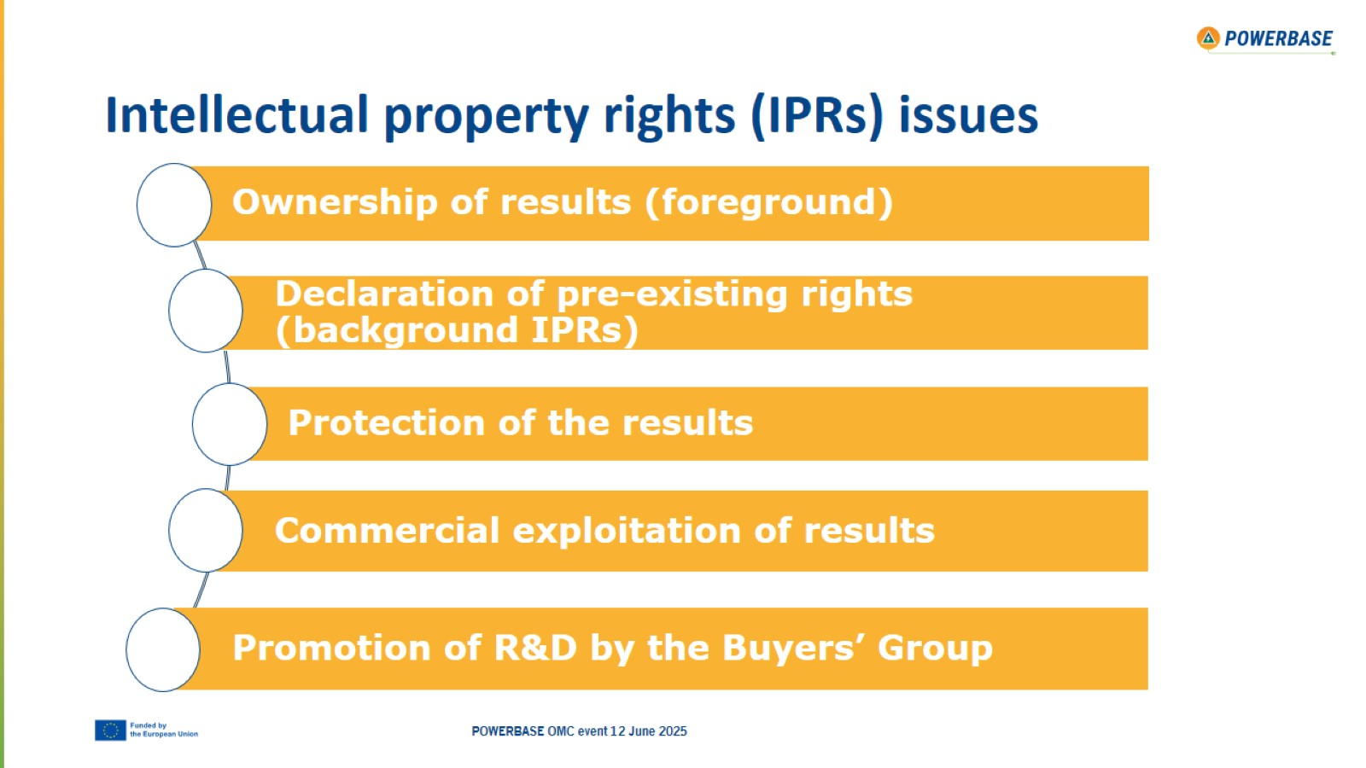
Intellectual property rights (IPRs) issues

Slide 34

Thank you!

Slide 35

State-of-the-Art

Slide 36
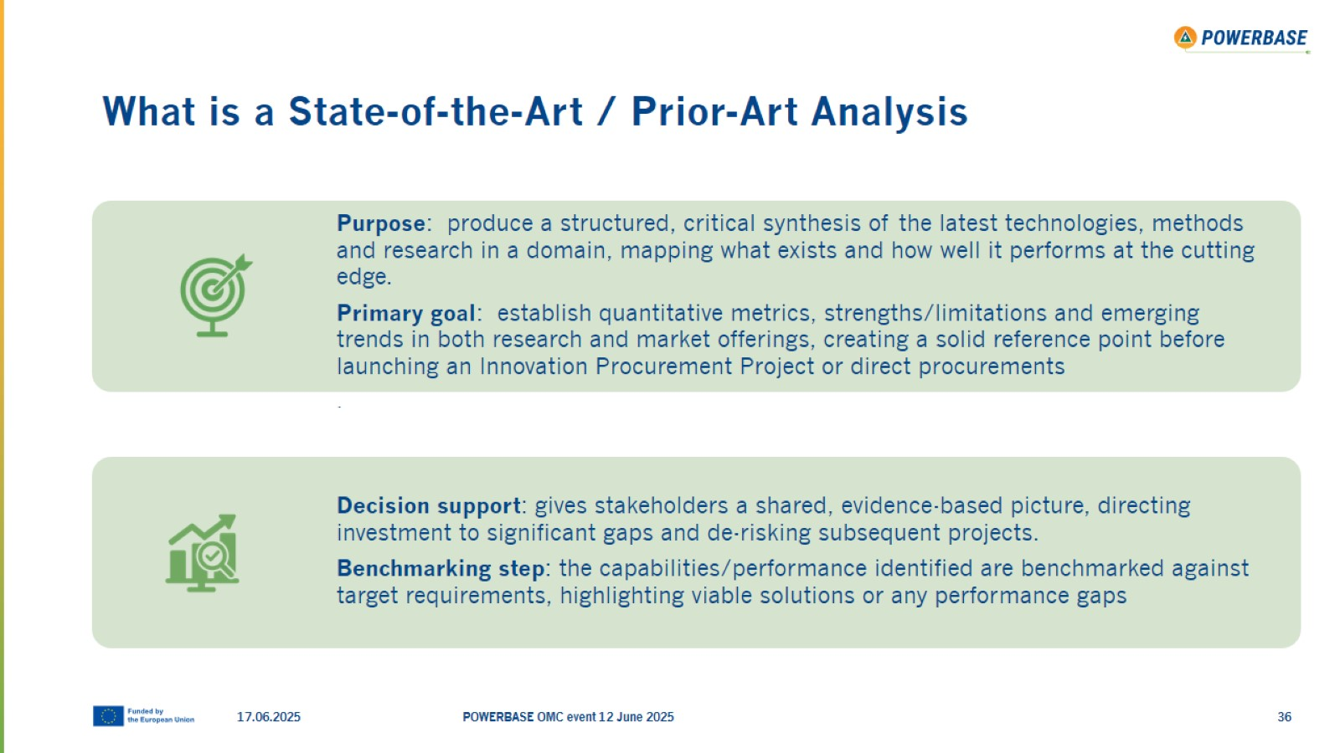
What is a State-of-the-Art / Prior-Art Analysis

Slide 37
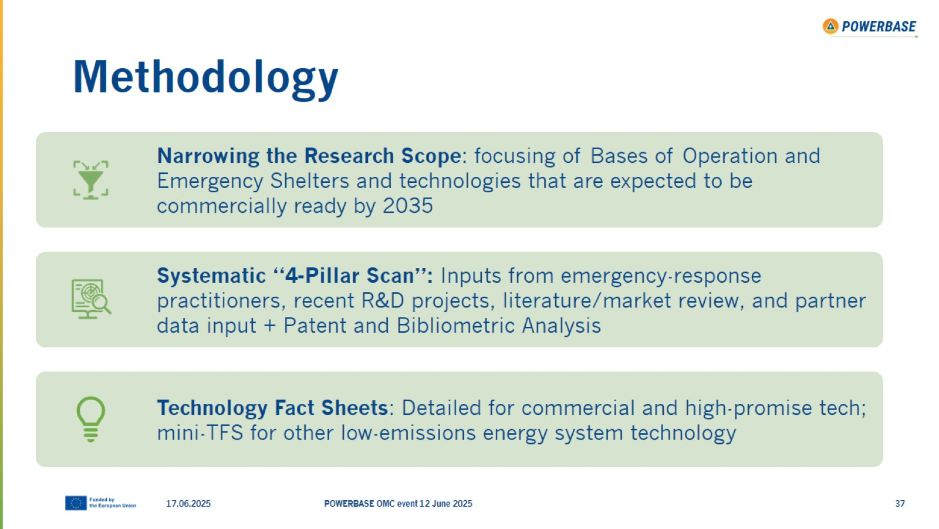
Methodology

Slide 38
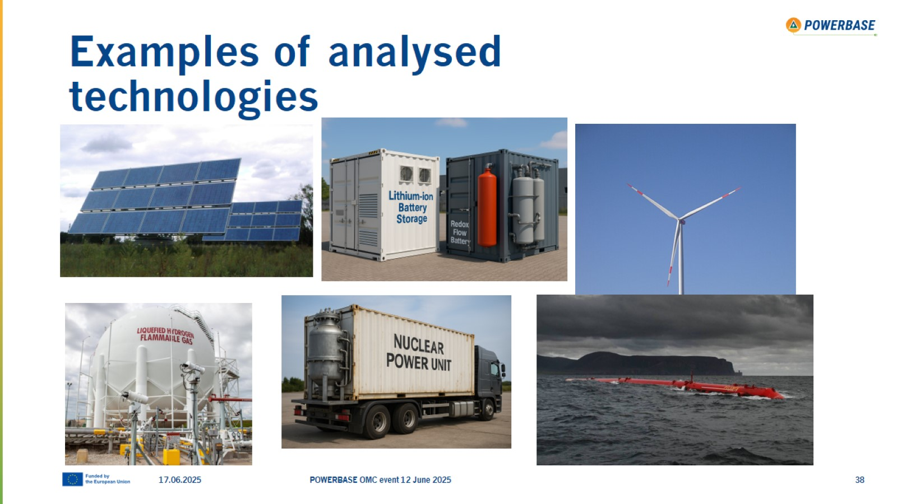
Examples of analysed technologies

Slide 39
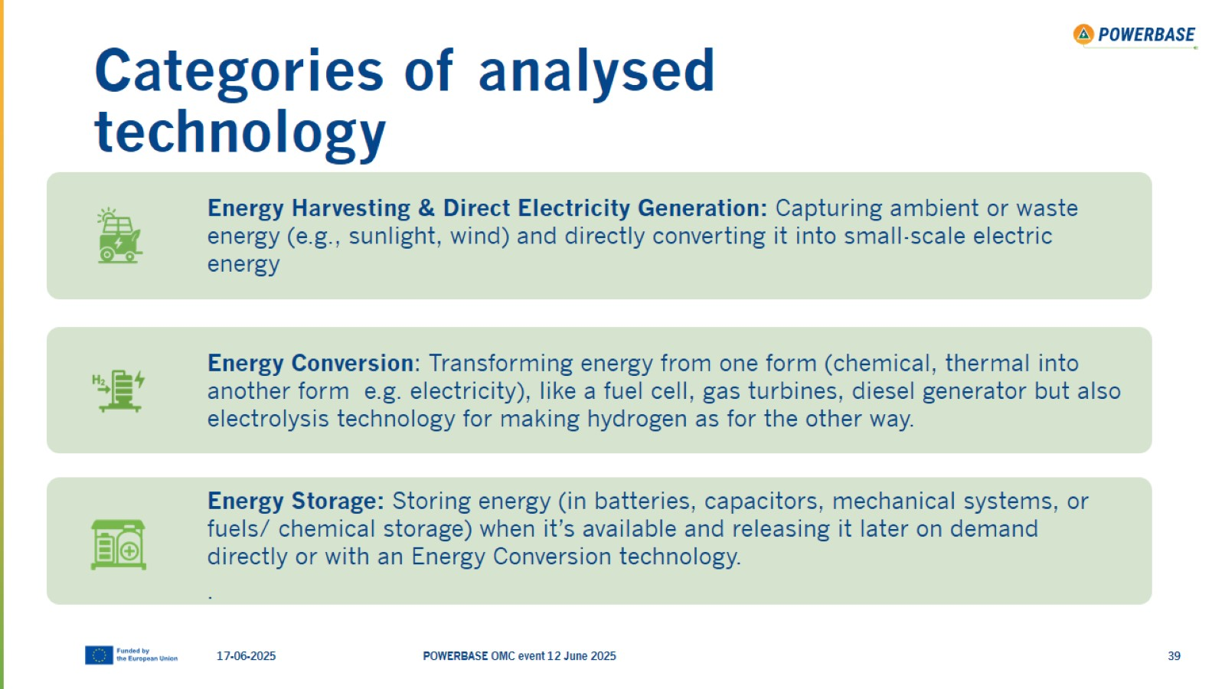
Categories of analysed technology

Slide 40
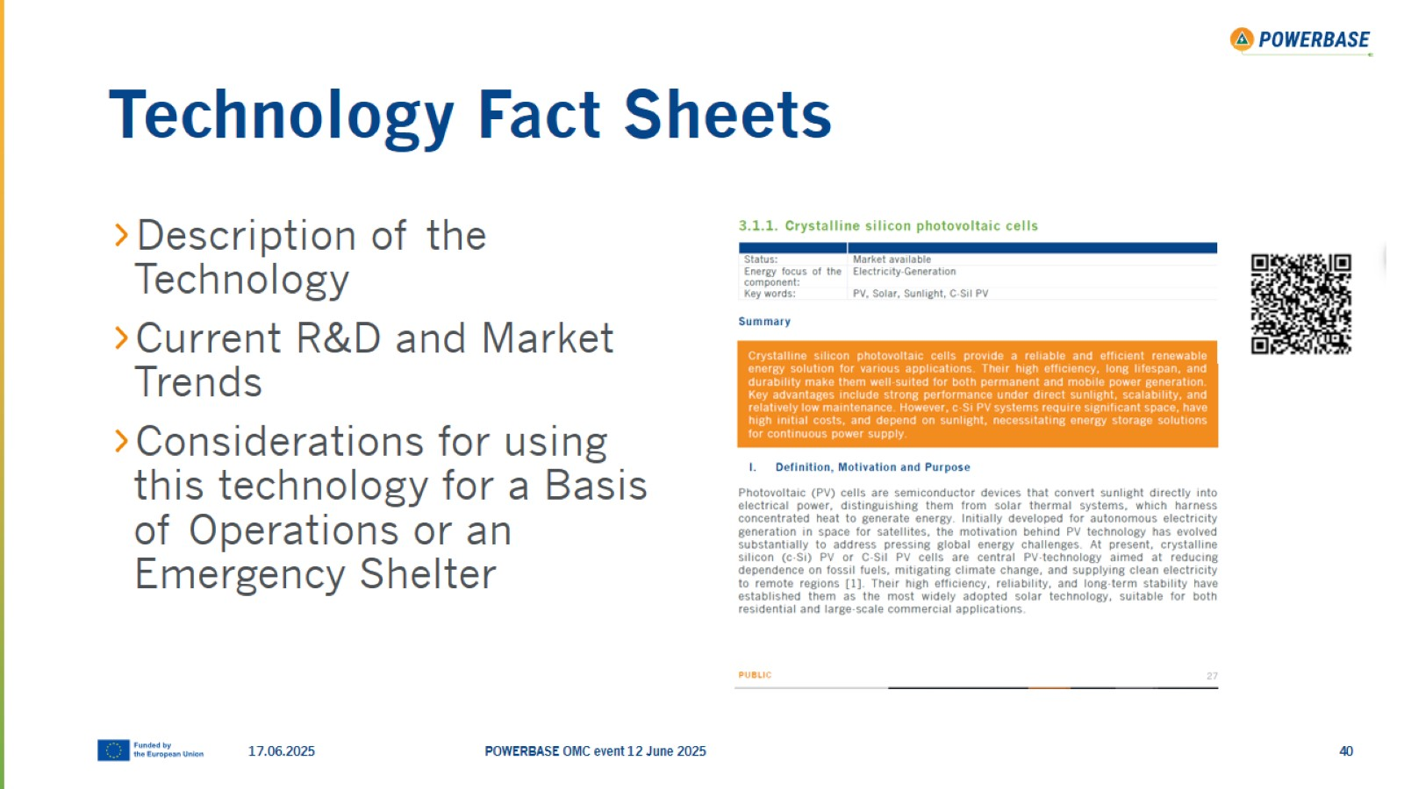
Technology Fact Sheets

Slide 41
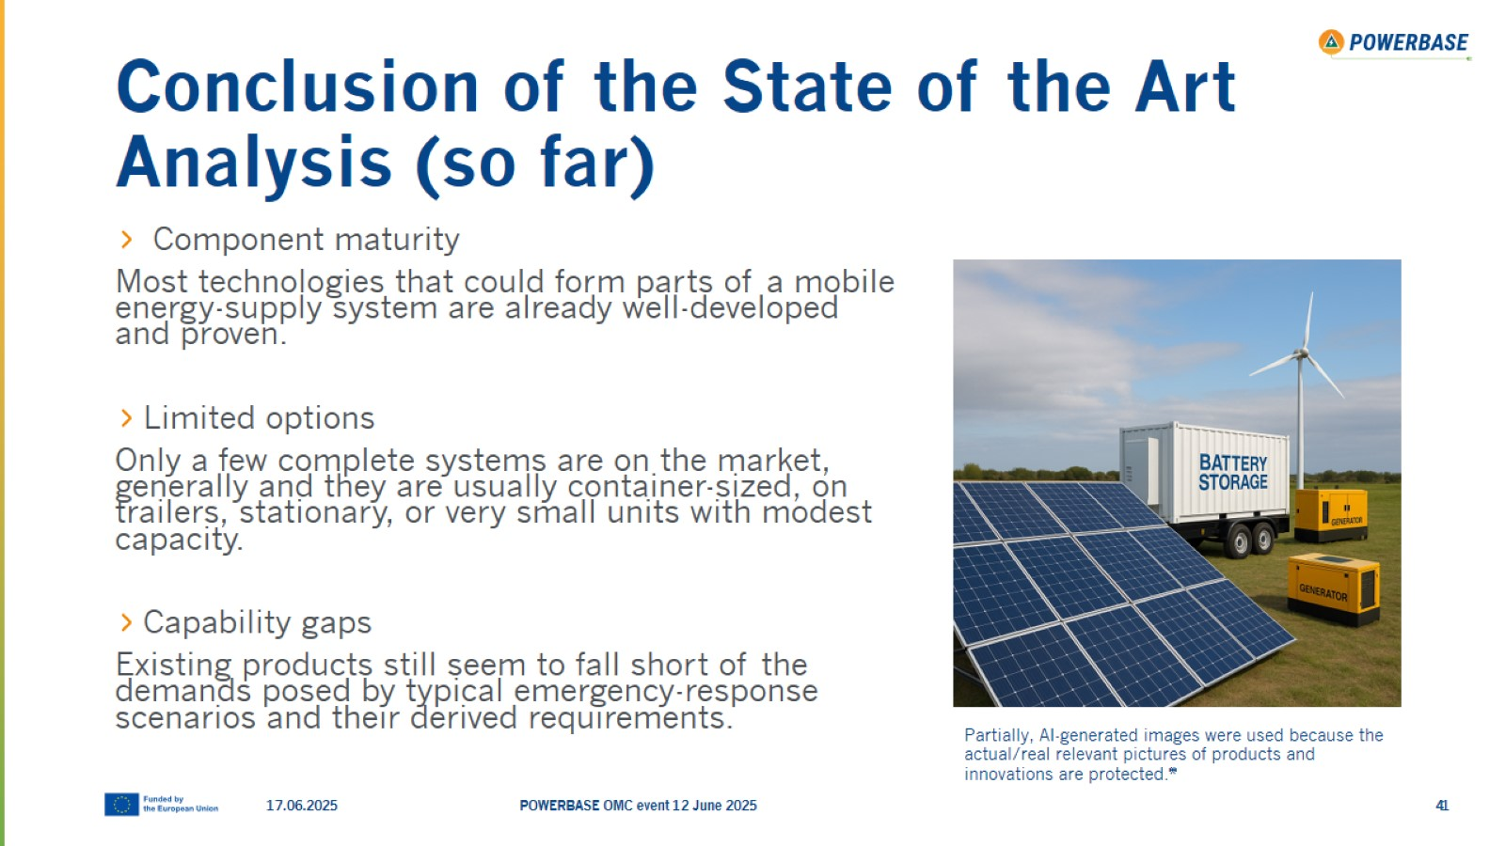
Conclusion of the State of the Art Analysis (so far)

Slide 42
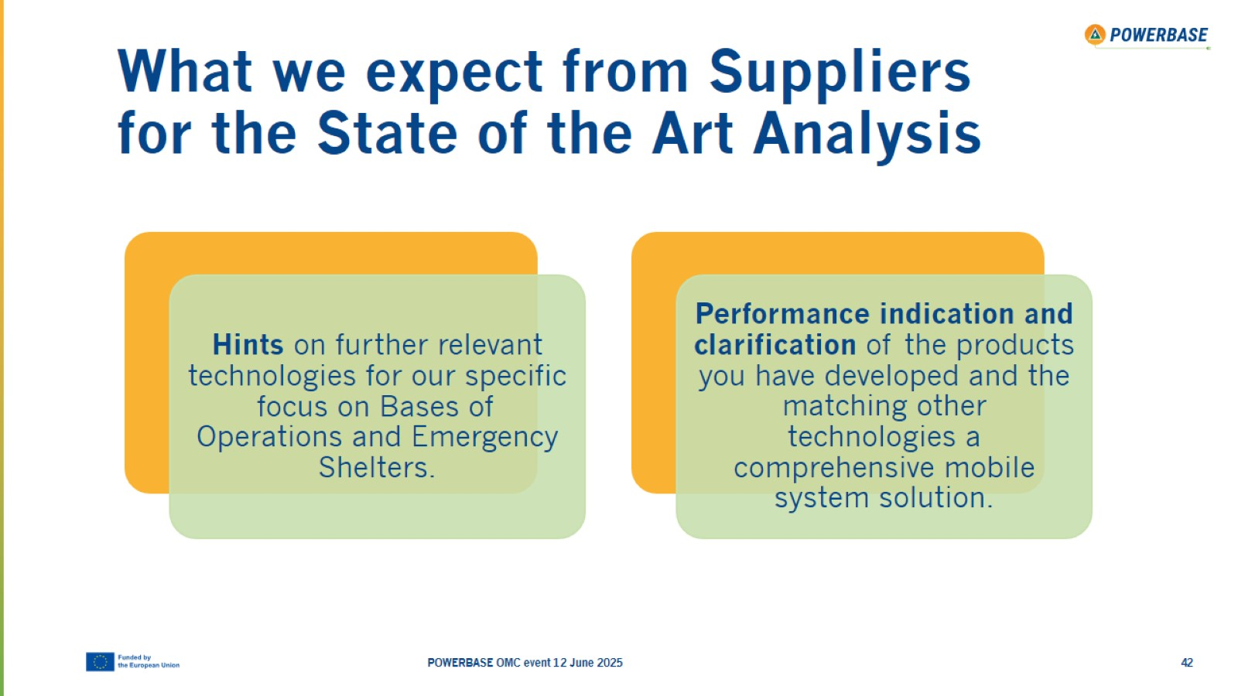
What we expect from Suppliers for the State of the Art Analysis

Slide 43

Thank you!

Slide 44

Scenarios

Slide 45
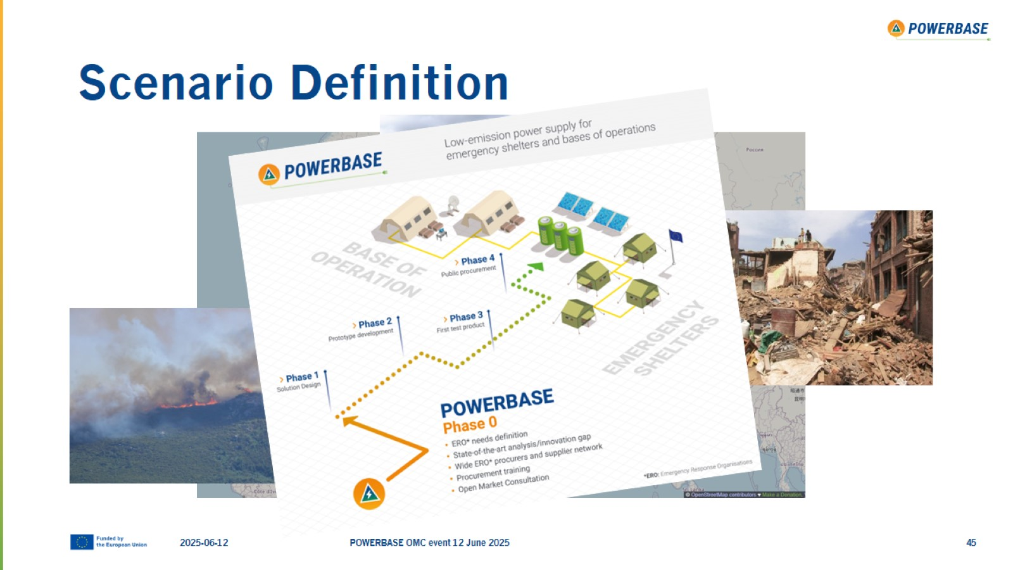
Scenario Definition

Slide 46
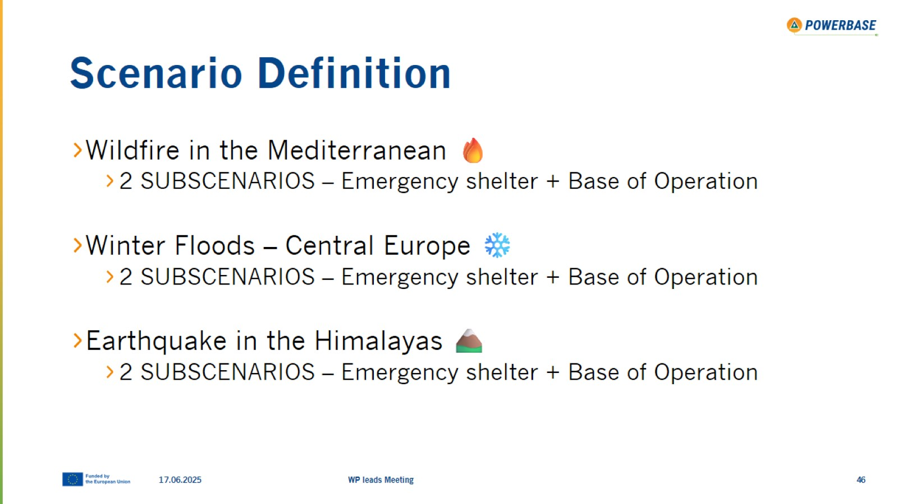
Scenario Definition

Slide 47
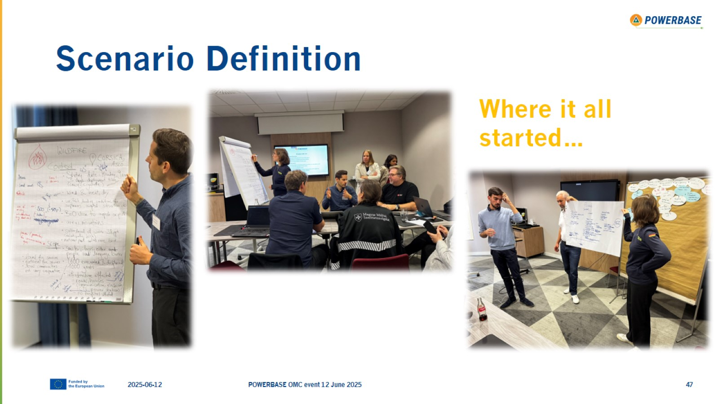
Scenario Definition

Slide 48
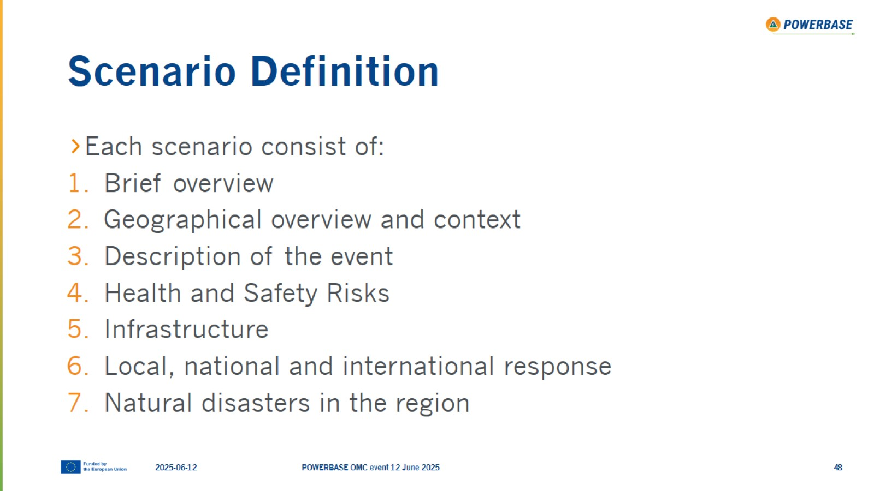
Scenario Definition

Slide 49
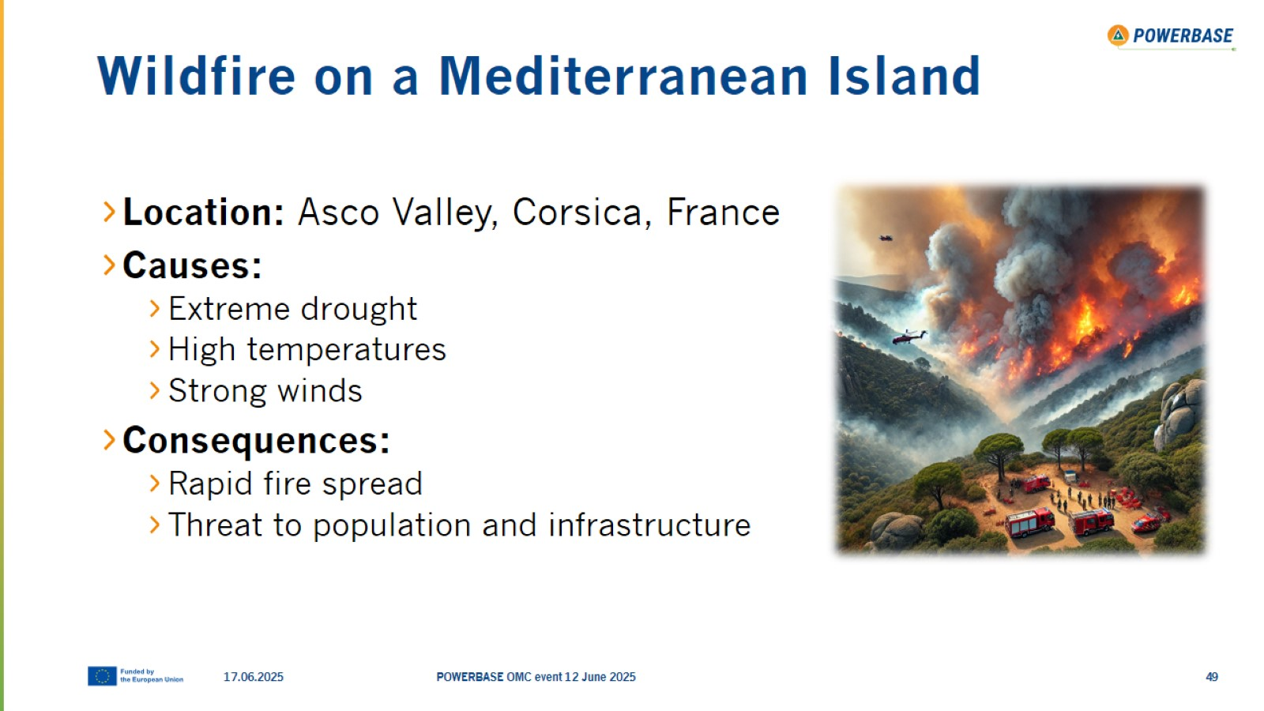
Wildfire on a Mediterranean Island

Slide 50
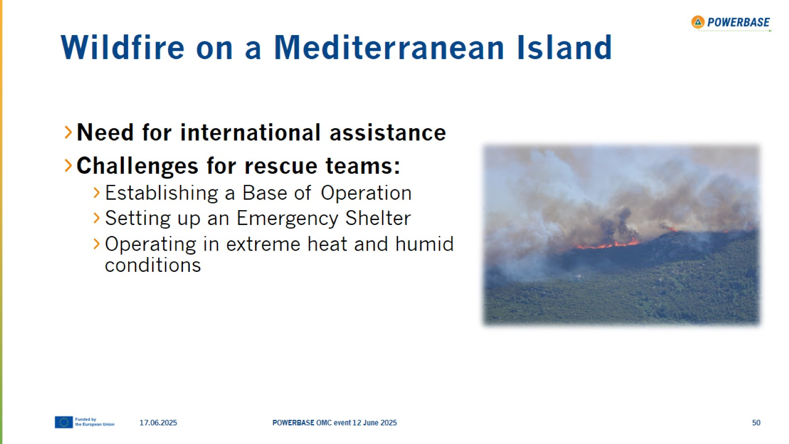
Wildfire on a Mediterranean Island

Slide 51
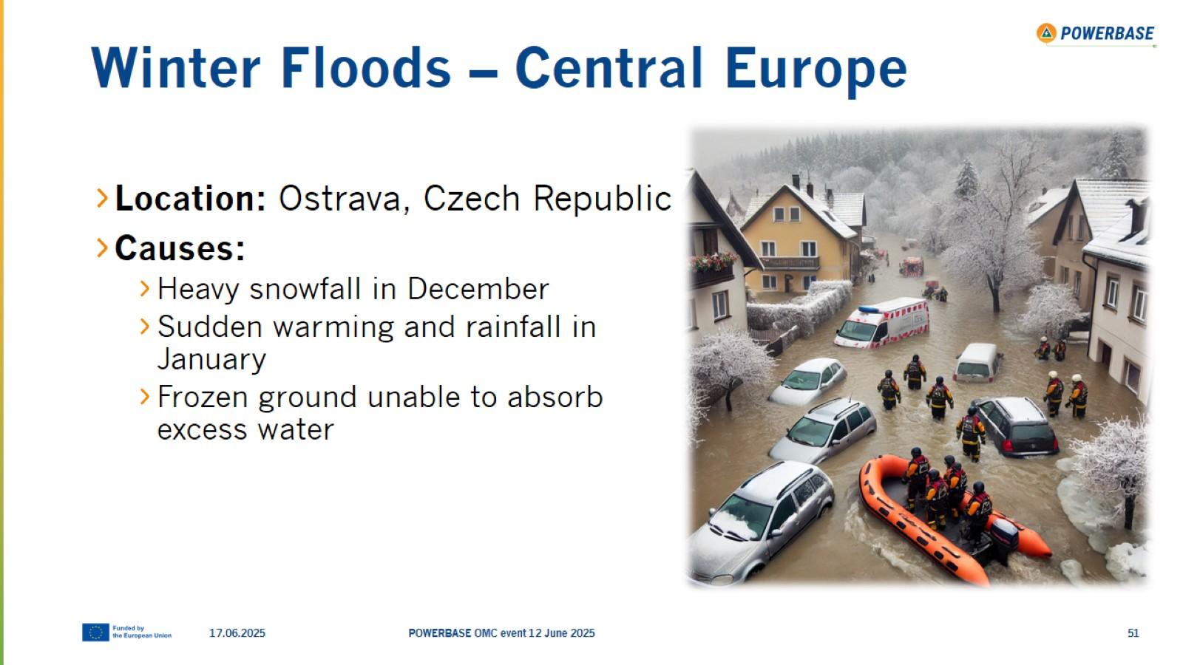
Winter Floods – Central Europe

Slide 52
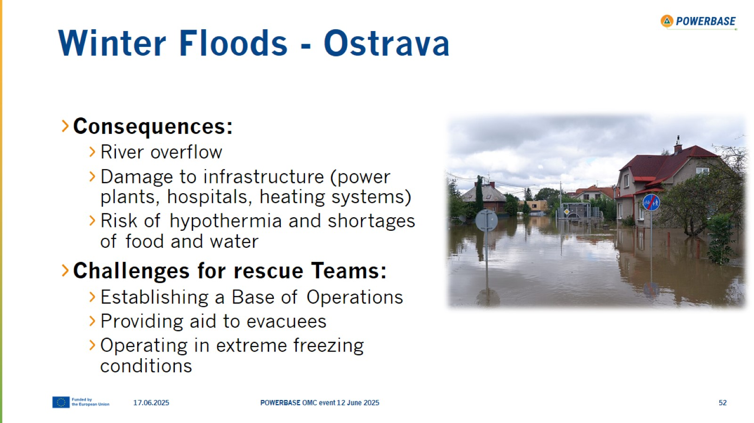
Winter Floods - Ostrava

Slide 53
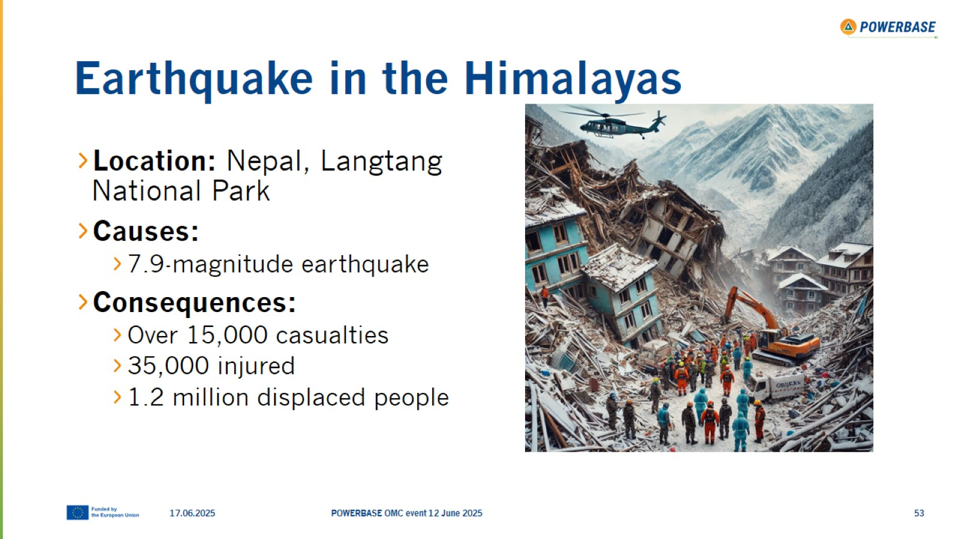
Earthquake in the Himalayas

Slide 54
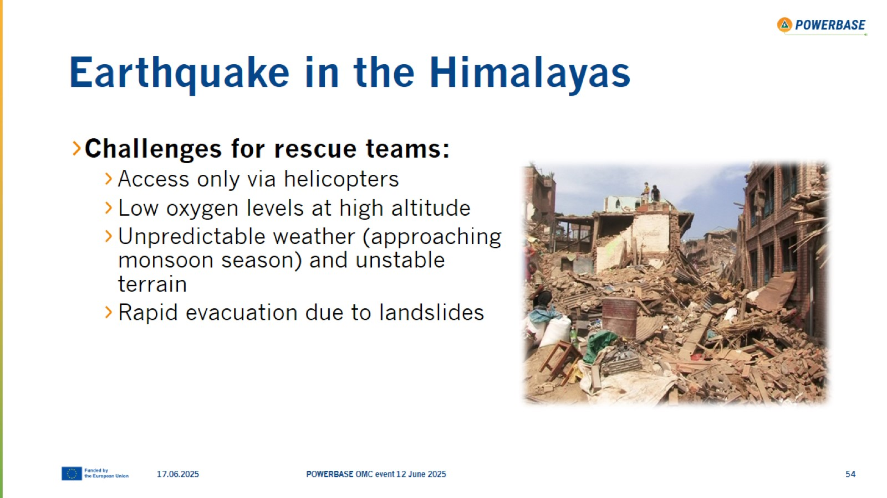
Earthquake in the Himalayas

Slide 55

Thank you!

Slide 56

Needs & Requirements

Slide 57
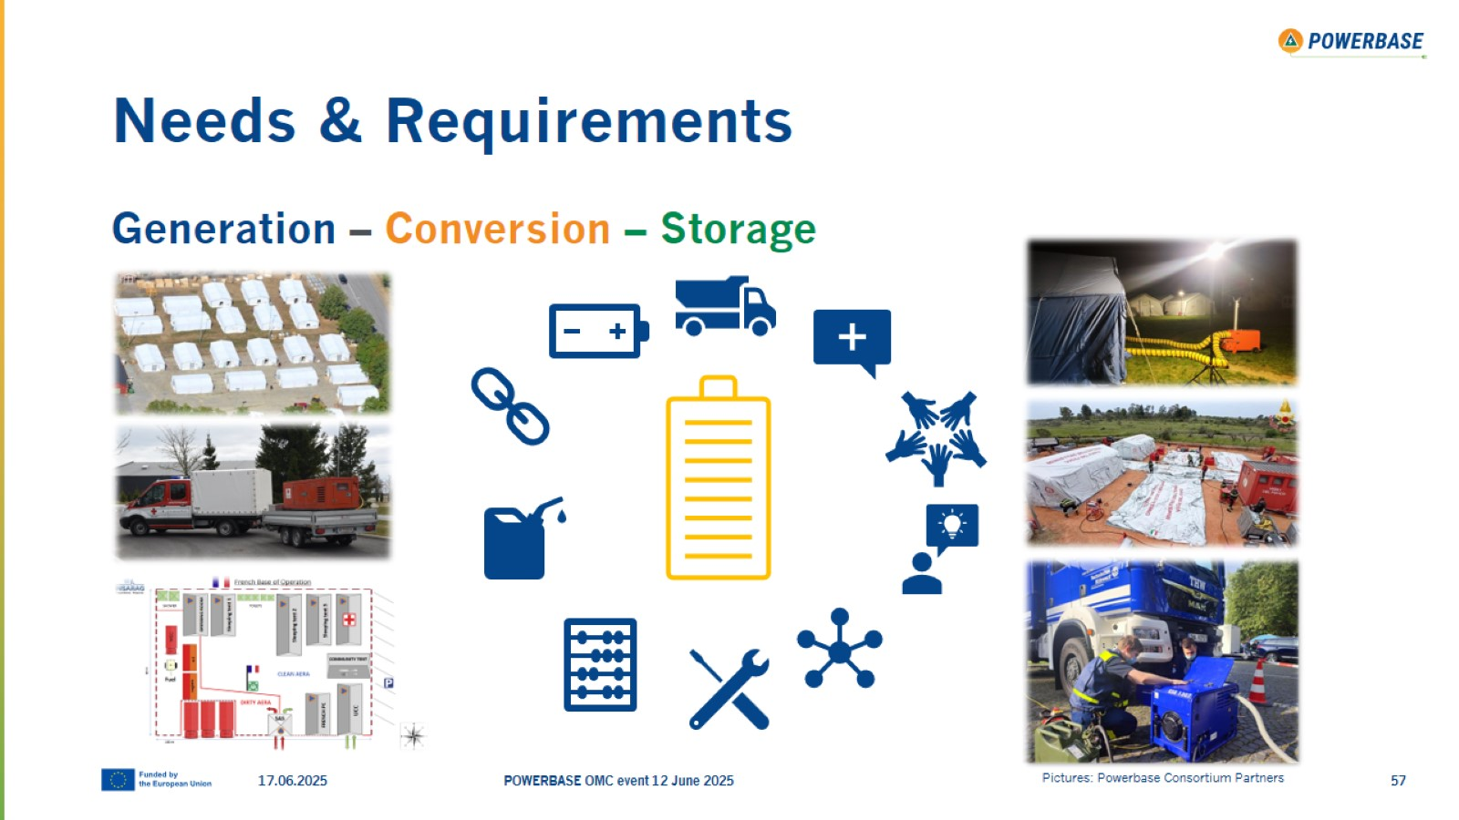
Needs & Requirements

Slide 58
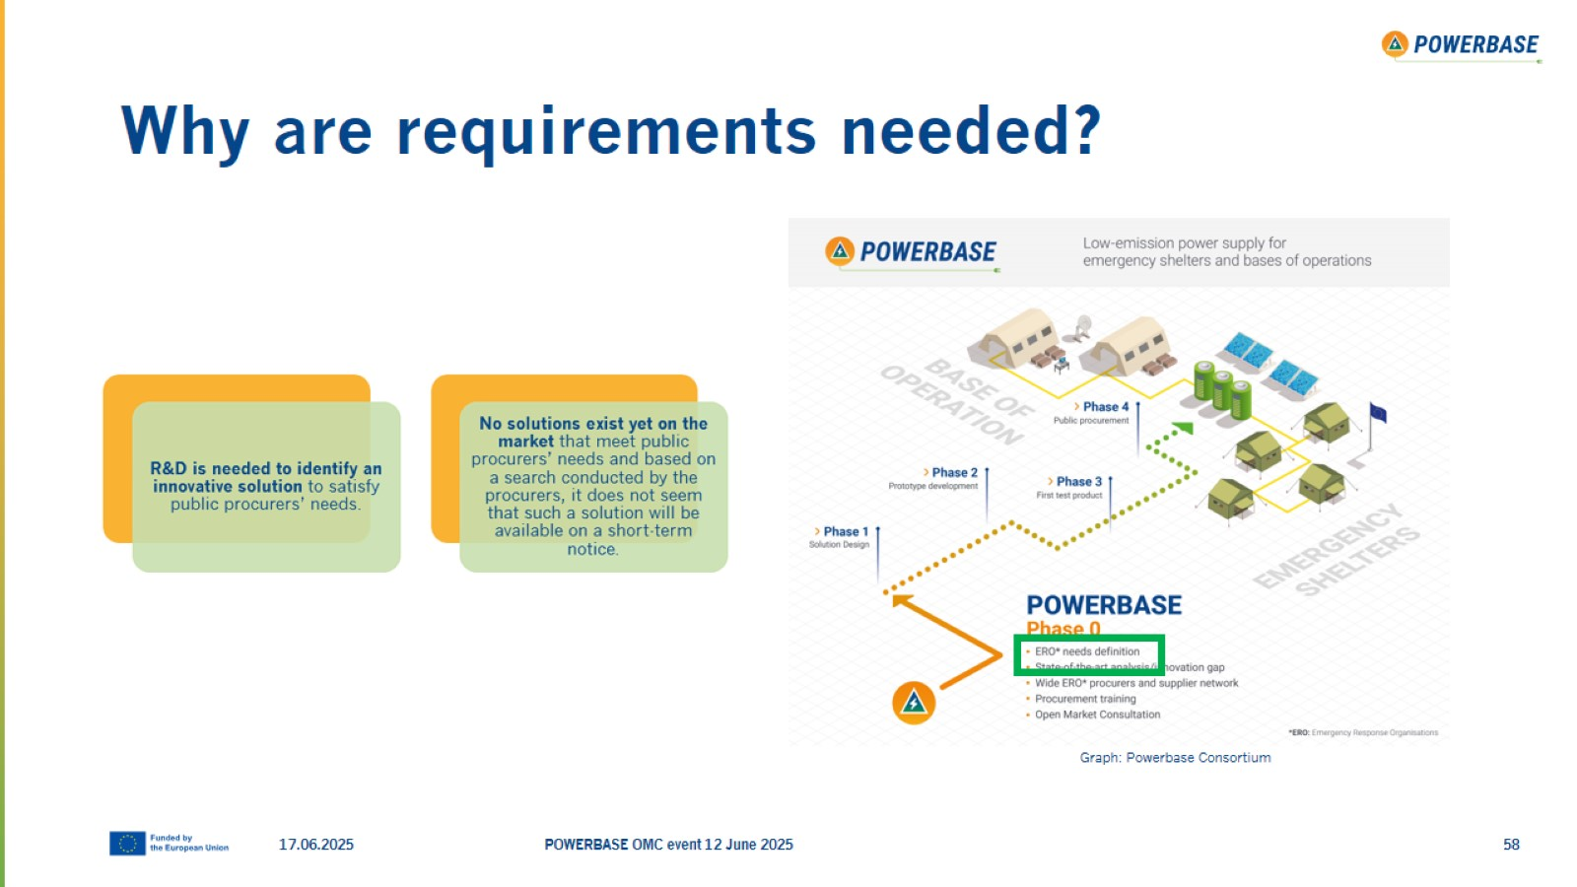
Why are requirements needed?

Slide 59
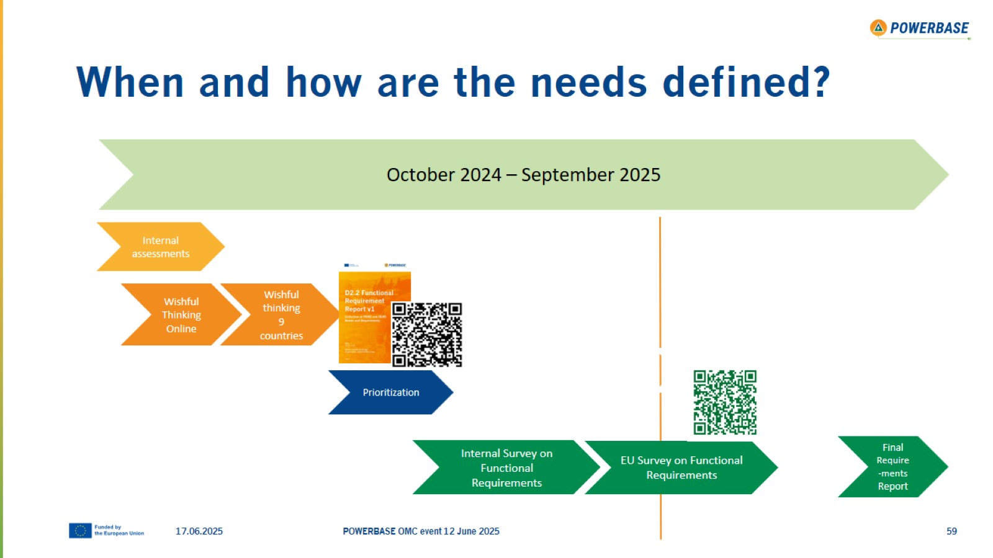
When and how are the needs defined?

Slide 60
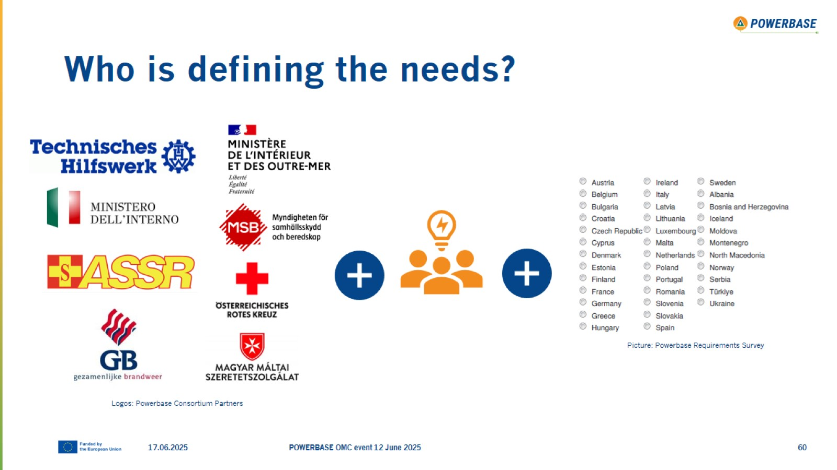
Who is defining the needs?

Slide 61
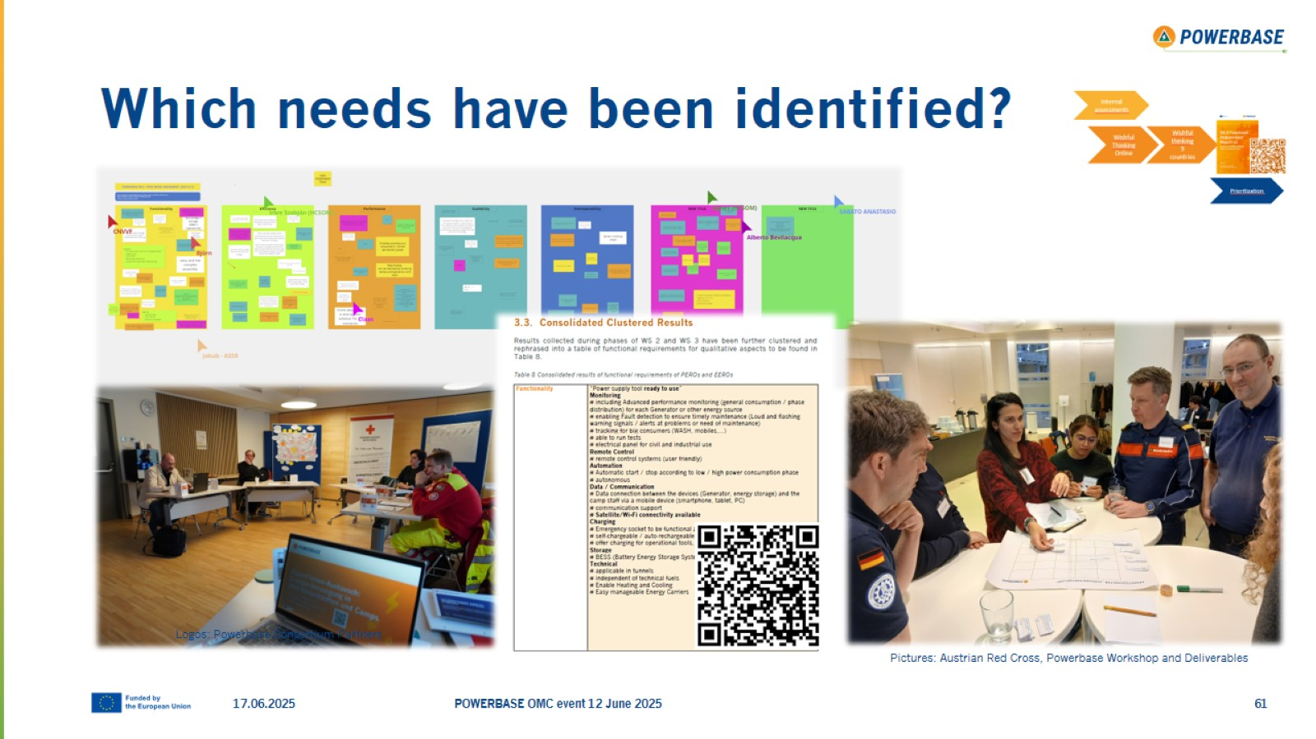
Which needs have been identified?

Slide 62
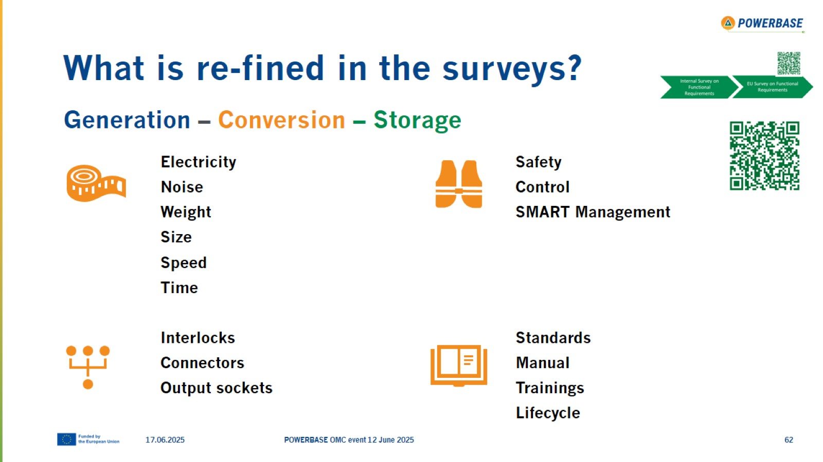
What is re-fined in the surveys?

Slide 63
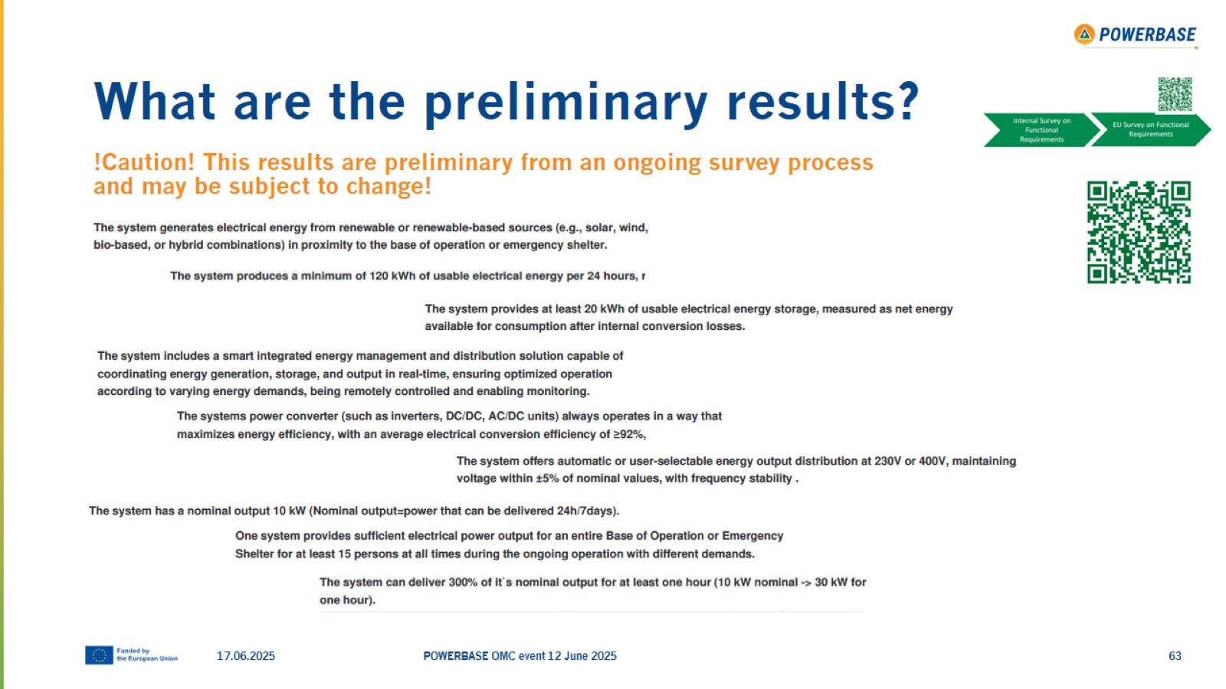
What are the preliminary results?

Slide 64
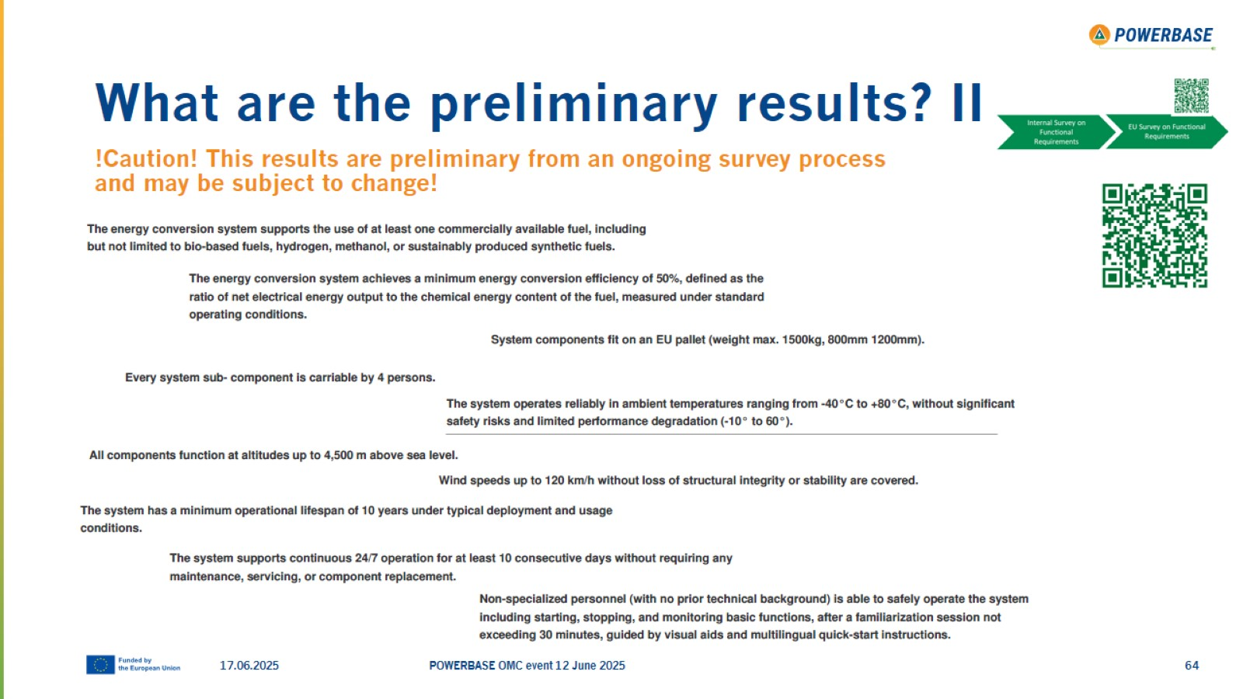
What are the preliminary results? II

Slide 65
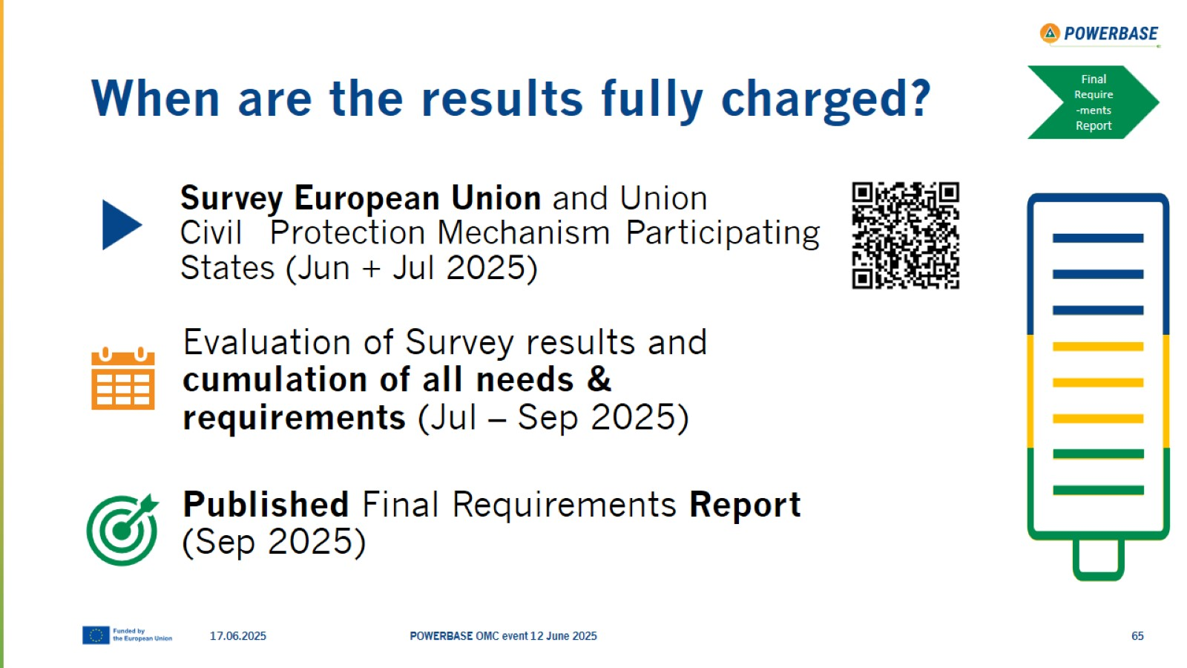
When are the results fully charged?

Slide 66

Thank you!

Slide 67

Q&A Session

Slide 68
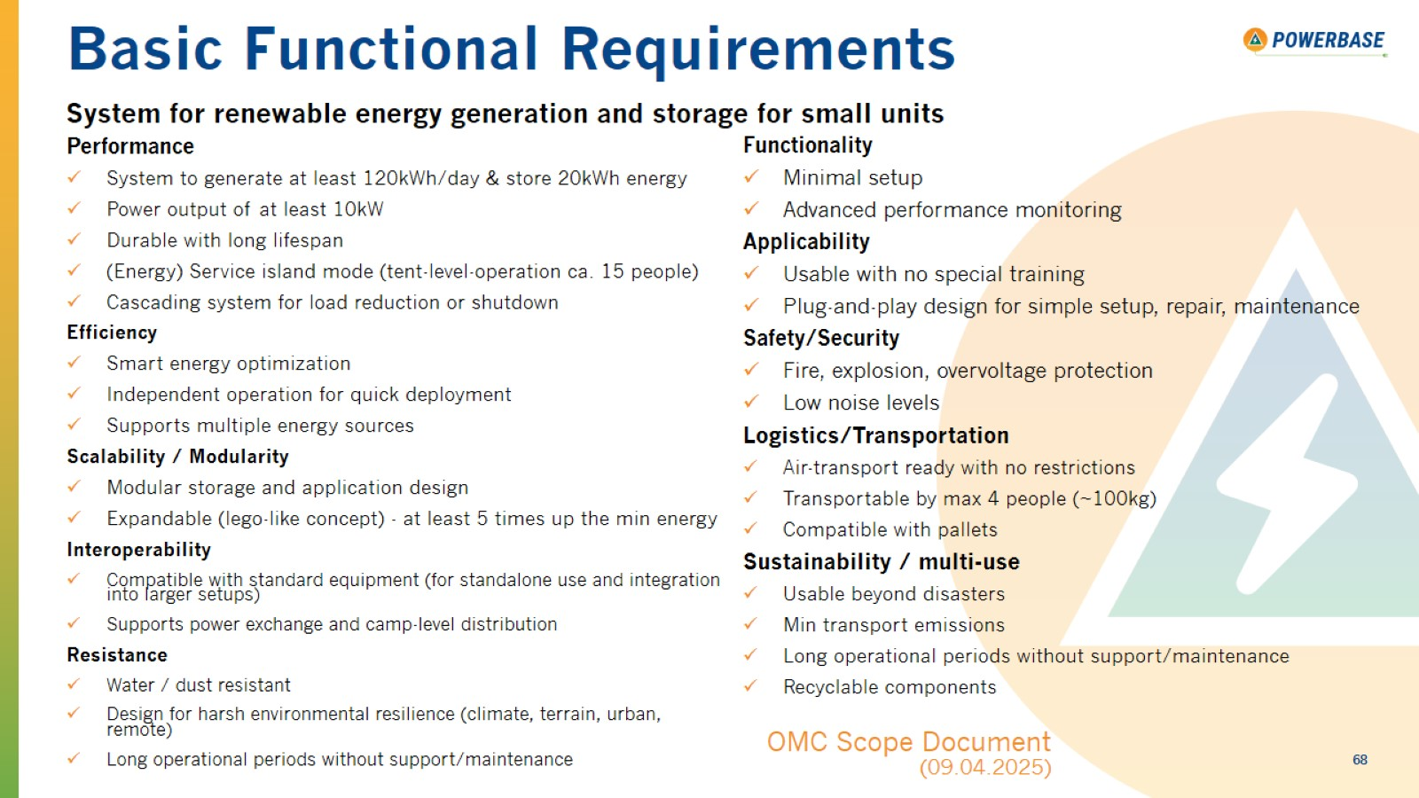
Basic Functional Requirements

